Slide 1
R Markdown
John Stephen
Statistical Analyst
Department of Preventive Medicine
9/21/2021

Slide 2
Description of R Markdown
Uses Markdown syntax
.Rmd file extension instead of .R
Supports multiple output formats (.html, .pdf, Word documents, and others)
Can display R code along with R output
Notes:
- R Markdown is a version of Markdown that allows you to incorporate R code with R output.
- Markdown is a markup language that lets you format text using code.
- There is native support for html, pdf, and word documents. Other output is possible as well.

Slide 3
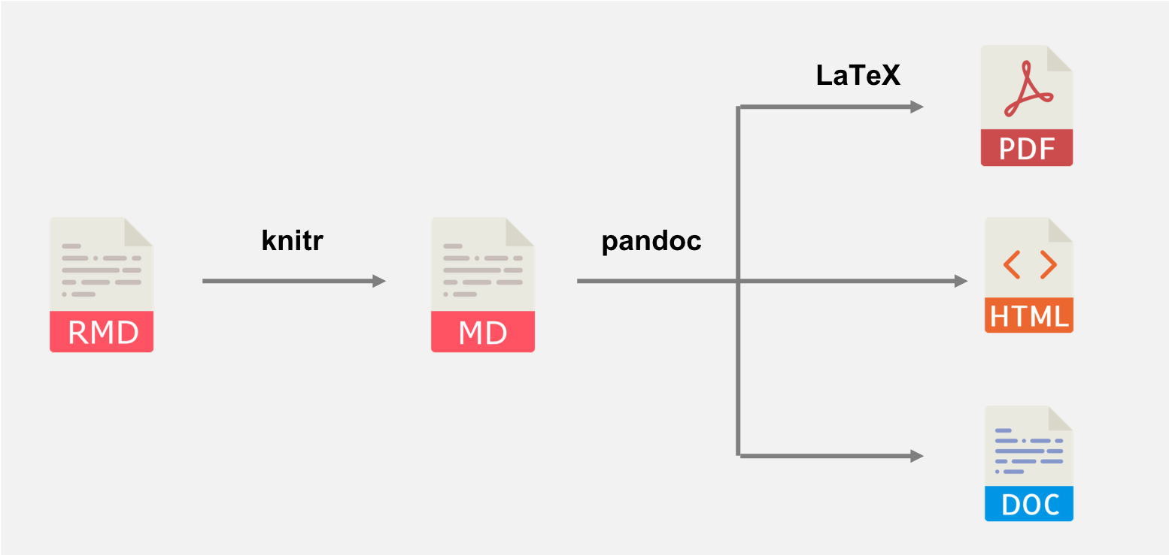
R Markdown process
R Markdown Cookbook
Yihui Xie, Christophe Dervieux, Emily Riederer
2021-08-17
Notes:
R Markdown Cookbook
Yihui Xie, Christophe Dervieux, Emily Riederer
2021-08-17

Slide 4
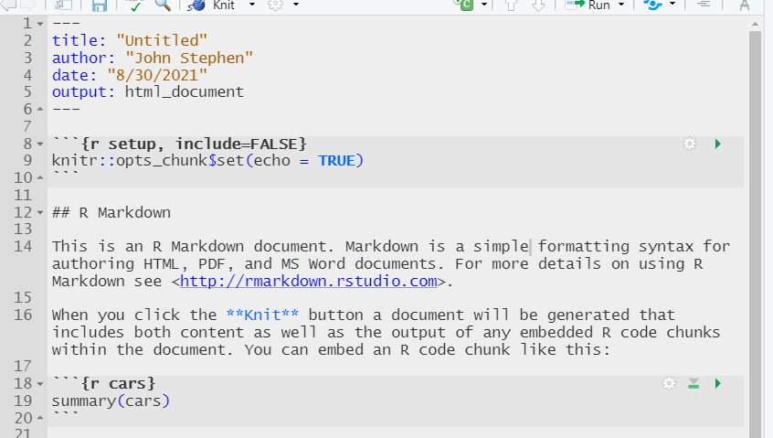
Sections of R Markdown file
Header
YAML metadata
“Chunk”
R Code that will be ran
Markdown text
Notes:
- Header:
- This is where we will specify configurations of the Markdown file.
- Here we can add a table of contents, specify output, and specify other configurations
- YAML is a programming language that is used to specify/pass config files
- Chunks:
- These sections will be interpreted as R code. Your code will be displayed if echo=TRUE. If echo=FALSE, then this code will still be processed, but not displayed.
- Note: You can name these, but you don’t have to.
- Markdown text:
- Will be displayed as text in your output.
- Markdown has it’s own syntax that lets you control the look of the text (bold, italics, etc)

Slide 5
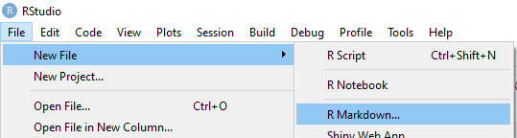
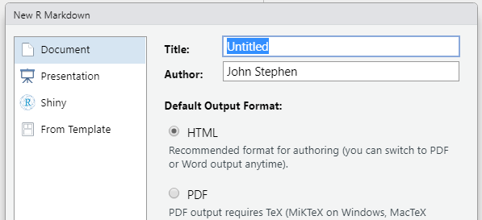
Creating a new R Markdown file
Can create a new R Markdown file using the file menu
The new R Markdown window lets you choose title of document, format, etc.
  These options get entered into the YAML header

Slide 6

Running R Markdown interactively
Can run the sections of code (“chunks”) interactively before creating your final output
Output is then displayed below chunk
Note: Sometimes your final output won’t look like output created interactively
Chunk options
Run all previous chunks
Run current chunk

Slide 7

“Knitting” R Markdown document
Creating R Markdown output is called “knitting” the document
Output is created by
  Clicking on the knit icon on the toolbar
  Or running the following code:
    rmarkdown::render()
  Example of knitting an R Markdown document using code:
    rmarkdown::render(input = 'Exercise_4.Rmd', output_format = 'html_document')
Notes:
- By default, document will be created in same folder as Rmd file.
- Can control this in the rmarkdown::render() function

Slide 8
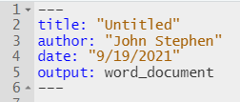
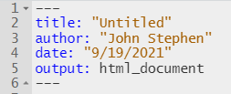
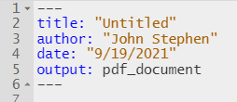
Output formats
R Markdown natively supports HTML, PDF, and Microsoft Word formats
You can control your output format:
  Through the wizard when you first create an R Markdown file
  In the YAML header
Note: You need LaTeX install to create pdf output.
Can install with tinytex::install_tinytex()
Notes:
- NOTE: Will need Latex install to create PDF output
One option:
tinytex::install_tinytex()

Slide 9
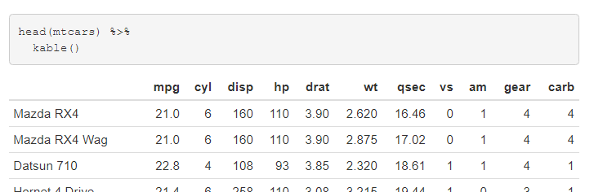
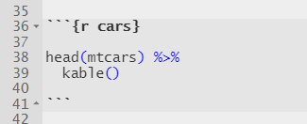
Code “Chunks”
R chunks are sections that contain R code
Start with ```{r} and ends with ```
  (Note these are back ticks, not single quotes)
Code:
HTML output:
Notes:
- These are the sections where you will write your R code that will be evaluated
- Add chunks by clicking on the icon, or typing in the code yourself.

Slide 10
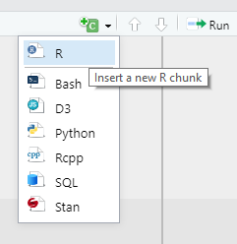
Code “Chunks” (cont.)
Multiple ways to insert an r chunk
  Use icon on toolbar
  Type manually with starting with ```{r} and ending with ```
  Windows hotkey: Ctrl + Alt + i
  Mac hotkey: Ctrl + Option + i

Slide 11
Code “Chunks” (cont.)
Chunks can contain a name, and several options
If chunk names are used, they need to be unique
Use commas to separate options (if used)
Chunk name (optional)
Option(s) (optional)
Notes:
- Chunks need to have the {r}
- They can contain a name, but it’s not necessary. Using names is good practice.
- Options have to come after a comma, and have to come after the r and name (if used).
- Use a comma inbetween each option.
- If you do use a name, make sure to make them unique

Slide 12
“Chunk” options
Examples of chunk options:
Option: Default: Effect:
eval TRUE Runs code in chunk
include TRUE Shows or hides R code and results in output
echo TRUE Shows or hides R code in output
error FALSE Controls whether R stops on error
warning TRUE Displays warning
message TRUE Displays message
Notes:
This is not an exhaustive list of the chunk options, only a sample.
Chunk options basically control how the code inside of it is evaluated and/or displayed.
Depending on your audience you may want to display or hide your code with the echo function.

Slide 13

Setting default options for chunks
Use the opts_chunk$set function to set default chunk options for your document
You can still change these options later in the document
Will display R code in output.
Will display R code, suppress warnings, and suppress messages in output.
Notes:
If you want most/all of your chunks to have the same options, you can set the default using the knitr package
You can then change options for each chunk as needed if you want something other than the default

Slide 14
Inline R code
Inline code lets you evaluate R code without a chunk.
The results will then be displayed with the text.
Inline code will display the results, but not the code.
Cannot use chunk options.
Starts with `r
Ends with `
Code:
Result:
Notes:
- What if you want to display R results in text without creating a chunk?
- Inline code lets you do this
- Good for values that you may want to update (for example if you’re using continuously updating data).
- This way you don’t have to remember to go through your document and update every instance of a sample size.

Slide 15
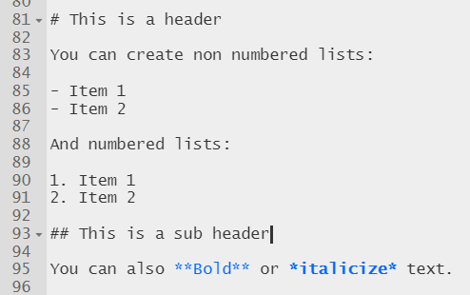
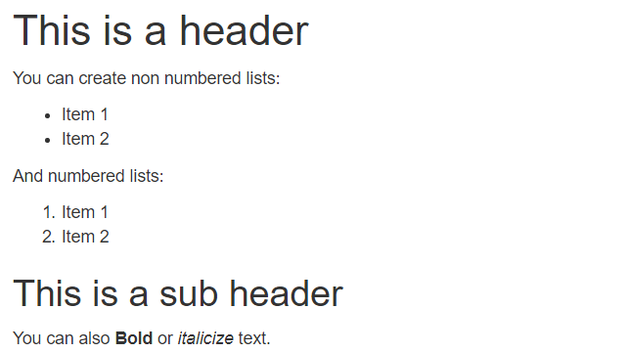
Markdown syntax
Code:
Output:
Notes:
- Headers are created using the pound or hash mark
- The less hash marks, the larger the header
- Headers come in handy with long documents
- Table of contents will also automatically populate with these headers (and will next based on number of hash marks)
- Markdown syntax can be a little finicky. If syntax is not showing correctly, try adding a space to the end of the text. Or hit return to start a new line.

Slide 16
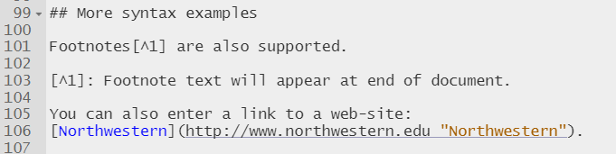
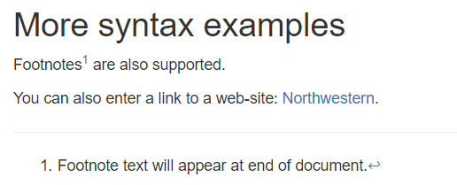
Markdown syntax (cont.)
Code:
Output:

Slide 17
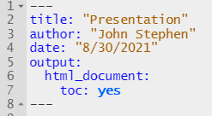
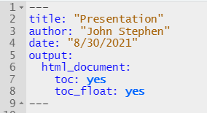
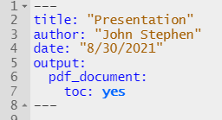
Table of contents
Create a table of contents by specifying it in the YAML header
R Markdown will populate your table of contents with your headers that are in your document
  (Text that starts with #’s)
YAML header for HTML output:
YAML header for HTML output:
YAML header for PDF output:

Slide 18
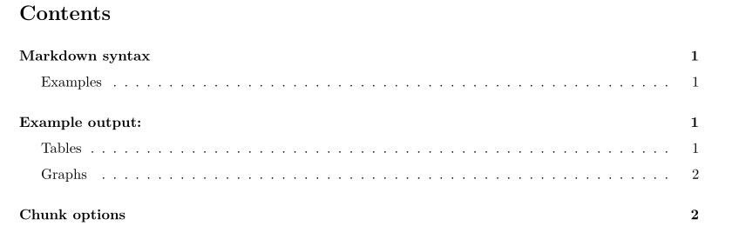
Table of contents (cont.)
R Markdown will take headers in your document and create a table of contents
Table of contents will nest headings based on the number of hash marks (#)
PDF output
#
##

Slide 19
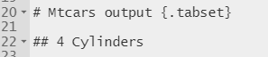
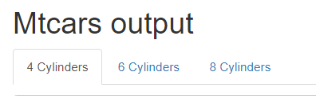

Creating tabs (html output)
Can group output in tabs
Start tab section by entering {.tabset} in parent header
Subsequent sub headers will appear as a tab
Output that is under each sub header will go into corresponding tab
End tabs by entering { - } in a header
Start:
HTML output:
End:
Notes:
Notice the parent header and the terminal header have same number of hashs
Sub headers inbetween that make up the tabs all have same number of hashs

Slide 20
Additional resources
R Markdown Cookbook
  https://bookdown.org/yihui/rmarkdown-cookbook/
R Markdown: The Definitive Guide
  https://bookdown.org/yihui/rmarkdown/
R Studio Cheatsheets
  https://www.rstudio.com/resources/cheatsheets/
R Studio R Markdown tutorial
  https://rmarkdown.rstudio.com/lesson-1.html

Slide 21
Exercise #1
First we’ll try creating output with text and some output of R code. Use the dataset mtcars for this exercise
mtcars is included with R, so you don’t have to download the dataset
  (Can load into environment using mtcars <- get(data(mtcars)) )
Try the following:
  Create an R Markdown file.
  Write R code to look at the first few rows of the mtcars dataset.
    (use head() function)
  Try writing some text to accompany your output. Try formatting your markdown text where appropriate.
  Knit your markdown file to html.

Slide 22
Exercise #2
Now we’ll try creating a plot and suppressing the code.
Try the following:
  Create a few plots looking at any associations that look interesting.
  Try suppressing the code for your plots, so that your report just has plots.
  Also try using inline code to integrate r results into your text.
    (you can look at numbers of rows and columns using nrow() and ncol()).
  Knit to html.

Slide 23
Exercise #3
Next we’ll try creating a pdf document
We’ll also add a table of contents
Note: if Latex is not installed on your computer, you may have to run tinytex::install_tinytex()
Try the following:
  Create a few plots looking at any associations that look interesting.
  Make sure to create headers for each plot. (Using #’s before your text).
  Try suppressing the code for your plots, so that your report just has plots.
    Instead of setting the options in each chunk, set the default to suppress code.
  Try adding a table of contents.
  Knit to pdf.

Slide 24
Exercise #4
Finally we’ll creating a document with tabs
Try the following:
  Think of a categorization you may want to use for some of the output you have created so far.
  Try creating tabs to categorize the output you have created so far (or create new output). Put them into the appropriate tab.
  Knit to html.

