Slide 1
Applied Statistics Seminar:
Grant Writing for Cancer Studies
Masha Kocherginsky, PhD
Professor of Biostatistics, Departments of Preventive Medicine
Director, Quantitative Data Sciences Core, Lurie Cancer Center
Northwestern University

Slide 2
Cancer related studies
Basic science and pre-clinical studies
Pilot studies
Phase I and II clinical trials
Clinical trials with biomarkers

Slide 3
Basic science grants
Typically basic science grants include multiple experiments
Challenge: scientific narrative is usually terse, difficult to understand what the experiments are
Collaborative approach:
  Review draft, make a list of experiments as listed
  Meet with the PI/study team
  For each experiment identify: type of sample, outcome measure, data type, overall design, correlation structure, preliminary data
  Work out sample size justification and analysis plan
“Statistical Considerations” need to include, for each experiment:
  Description of experimental design
  Outcome measure type (continuous, binary, count, etc)
  Analysis plan
  Sample size justification – number of samples, replicates, or other relevant units

Slide 4
Basic Science grants – common studies and outcomes
In vitro (e.g. cell line experiments)
  Cell lines come from a single subject, usually not combined across cell lines
  Smaller variability
  Usually simple statistical methods
  Generalizability?
In vivo (mouse xenografts, PDX models, etc)
  Tumor growth (calipers or imaging) – linear mixed models
  End of experiment excised tumor assays (two-sample tests or ANOVA/linear regression models)
Immunohistochemistry (IHC) – ordinal (manual scoring) or continuous (pixel-based image analysis)
  Manual scoring is often dichotomized as positive/negative → Fisher’s exact test or chi-squared test
  Continuous scoring is usually % staining → Wilcoxon test is reasonable
  Is expression normalized to something else? → log-transform
RT-PCR: use mixed models based on the 2^{-ΔΔCt} approach
Other types: expression, cell counts
Tissue sample analysis - association of biomarker levels with clinical outcome (usually OS, PFS)
Genomic data (RNA-Seq, methylation, etc)

Slide 5
Example: statistical analysis plan
Example: in vitro and in vivo studies
In vitro:
  Metabolic analysis in Aim 1 will be conducted in several cell lines (MCF7/T47D, HMECs/MMECs, and MCF10A cells), and will produce continuous measures from a variety of assays which will be compared between experimental conditions within each cell line.
  Two-group comparisons will be conducted using the Wilcoxon ranksum test, and multiple groups will be compared using the Kruskal-Wallis test.
  In addition, linear regression models with each assay as the outcome variable will be used.
In vivo:
  In vivo xenograft studies will measure tumor volume 3 times/week for 6 weeks, and linear mixed-effects models with repeated measures will be used to compare tumor growth curves between treatment groups.
  The models will include tumor size as the outcome, with treatment, time and their interaction as fixed effects, and mouse as a random effect. Within-mouse correlation between repeated tumor measurements will be accounted for using an appropriate variance-covariance structure, e.g. autoregressive of order 1 (AR(1)).

Slide 6
Power calculations
Power calculations may be challenging - usually due to lack of preliminary data
  Usually majority of outcomes are continuous (e.g. biomarker expression)
  Need mean and SD, and a target effect size
  Investigators rarely have such data
Literature search:
  Ask for publications, ask to highlight relevant numbers in a PDF
  Tables and text: look for mean ± SEM → convert to mean ± SD
  Figures: look for error bars and n → convert to mean ± SD, use Acrobat measuring tools
If no prelim data are available, can give power curves for a range of differences (e.g. 1.5 to 2.5 fold change, or 10% - 30% difference), then compare to effect size in similar studies
Usually 80% power, α = 0.05, two-sided
Multiple comparisons adjustment – usually Bonferroni if only a few biomarkers (up to ~5-10)

Slide 7
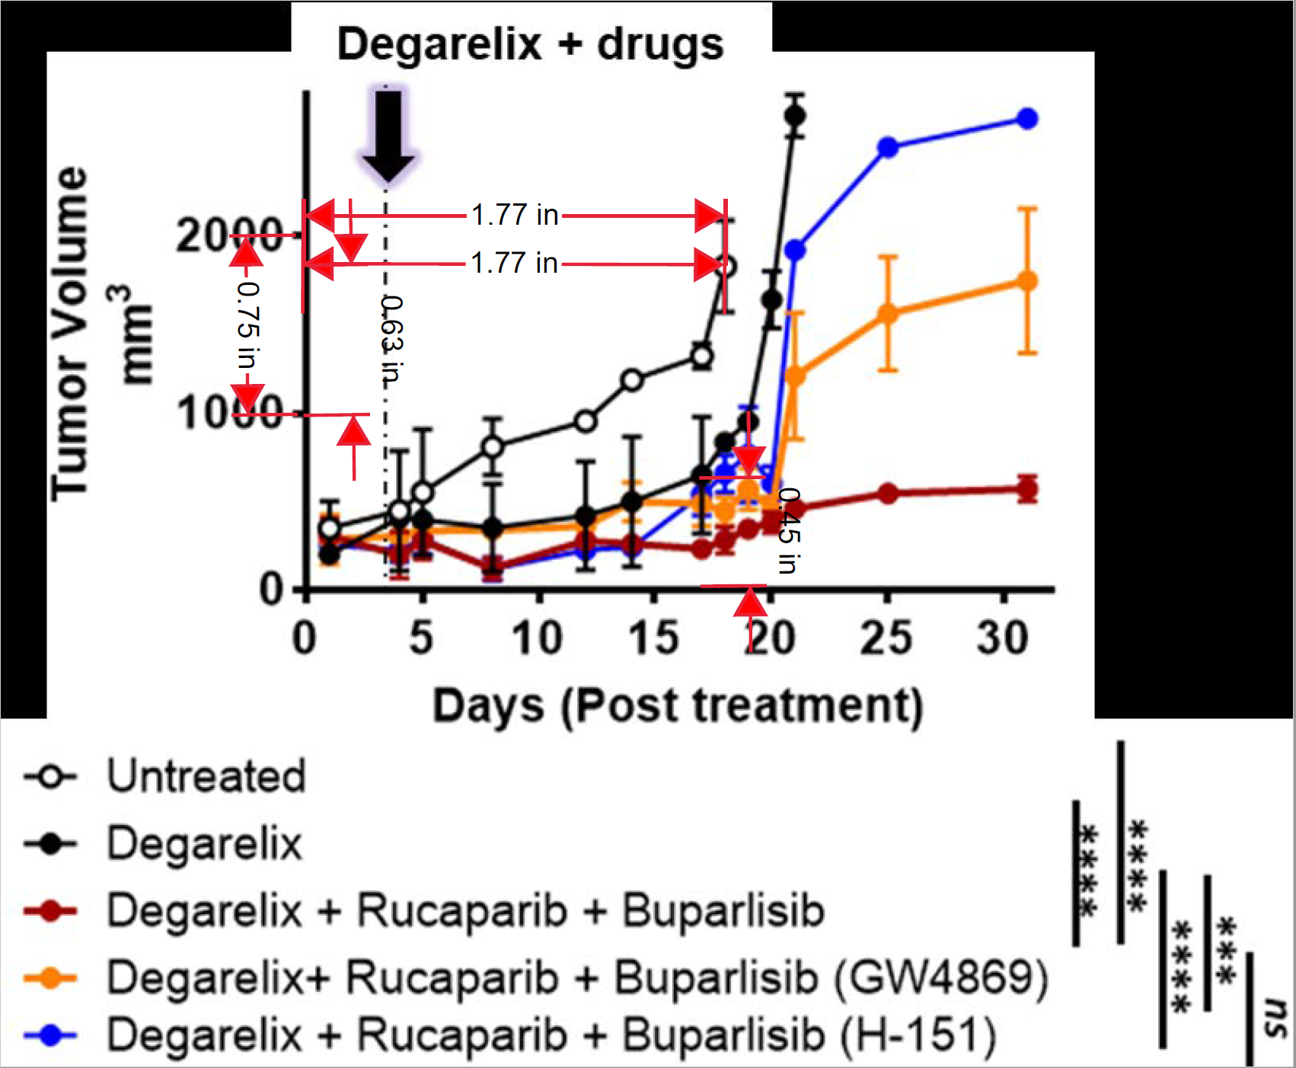
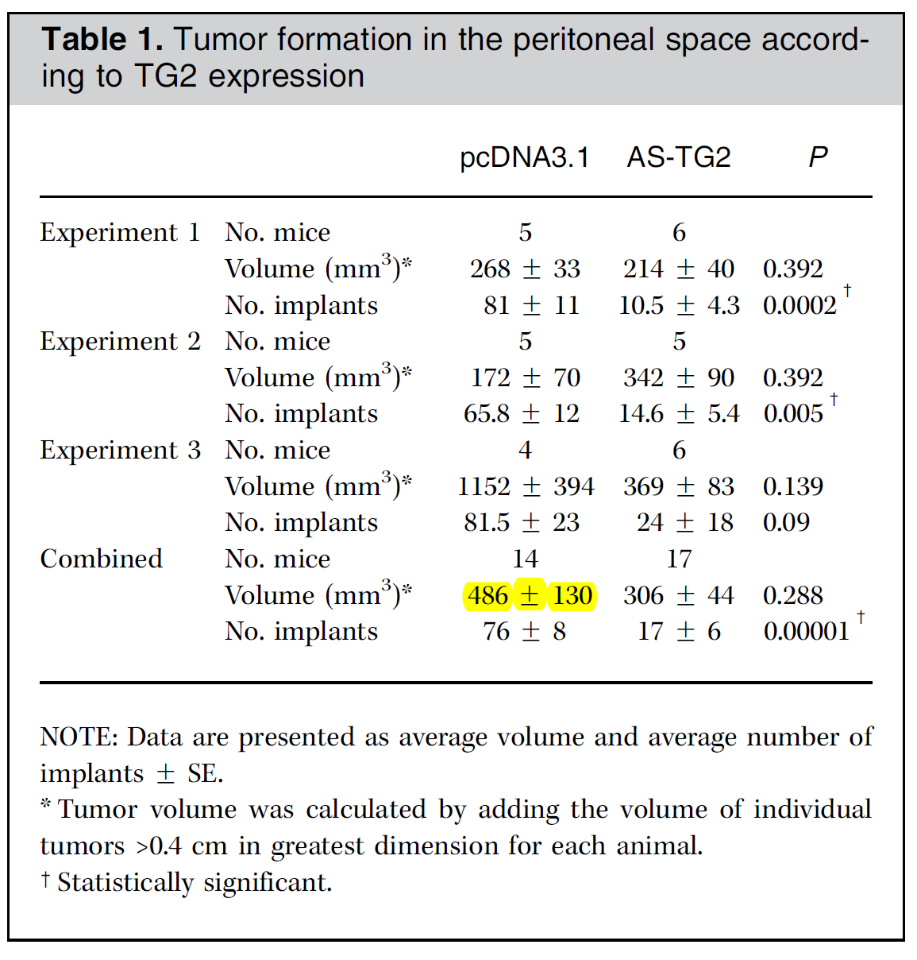
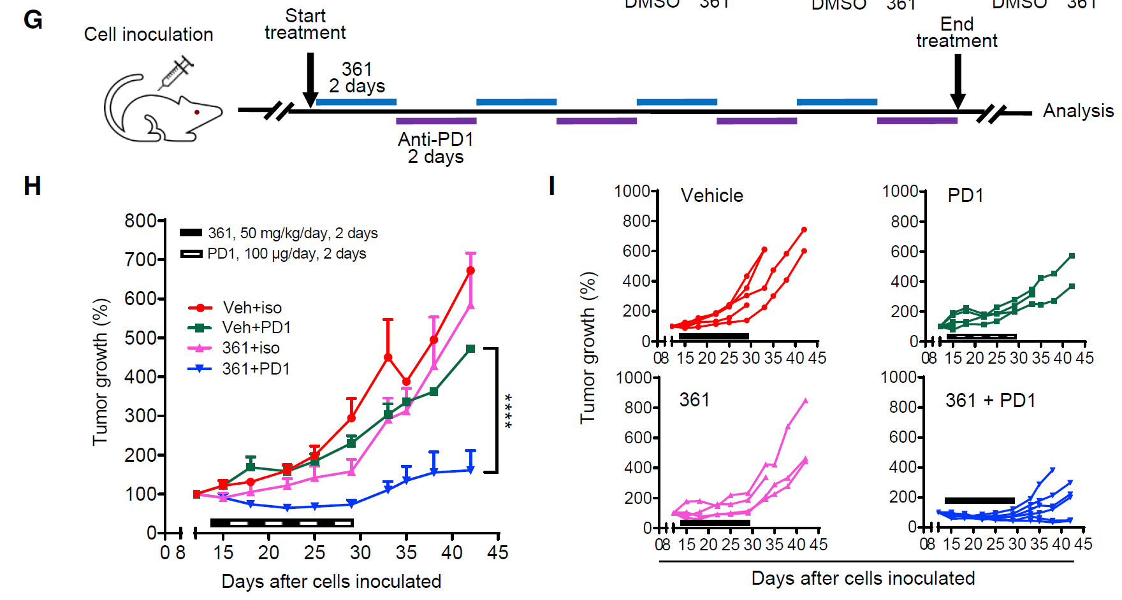
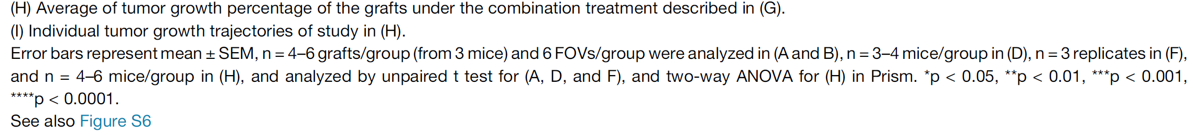
Power calculations – getting preliminary data
Ask for relevant publications
Tables and text: look for mean ± SEM → convert to mean ± SD
Figures: error bars and n → convert to mean ± SD, use Acrobat
measuring tools
“Reconstruct Individual Patient Data From Kaplan-Meier Survival Curve” tool - trialdesign.org

Slide 8
Example: power and sample size for mouse studies
Because mice will be randomized to treatment groups when their tumors are approximately of the same size, the power analysis is based on a simple comparison of tumor size at the end of the study using a two-sample t-test.
A sample size of n=19/group will provide 80% power with two-sided α=0.05 to detect a standardized effect size Δ=0.93. A standardized effect size of Δ=1.16 can be detected with α=0.05/5=0.01 significance level when using the Bonferroni correction to adjust for multiple comparisons (5 treatments vs. control group).
Assuming similar variability as in Fig. 8b, where SD≈200mm² in all groups at the end of the study, these effect sizes correspond to a difference of approximately 190 mm² and 230mm², respectively, which are smaller than the observed differences of >700 mm² between treatment groups and Vehicle control, and are comparable to a Day 45 difference between Drug1 vs Drug1+Drug2.
Drug1 + Drug2
Drug1
Drug2
Control

Slide 9
Genomic-type endpoints: power analysis
Control FDR to adjust for multiple comparisons when doing power calculations
  Determine at what α-level to test
  Need to make some assumptions (number of features tested, rate of truly differentially expressed genes) – check with PI
  PASS has a procedure for this, also see Dobbin and Simon, Biostatistics 2005
Can use TCGA or other public databases to get preliminary data
Experimental design – may need non-standard approaches, e.g. if paired design or Cox regression
Collaborate with our bioinformatics colleagues (Drs. Elizabeth Bartom and Matt Schipma, QDSC - Bioinformatics)
  Pre-processing, normalization, Bioconductor packages, etc

Slide 10
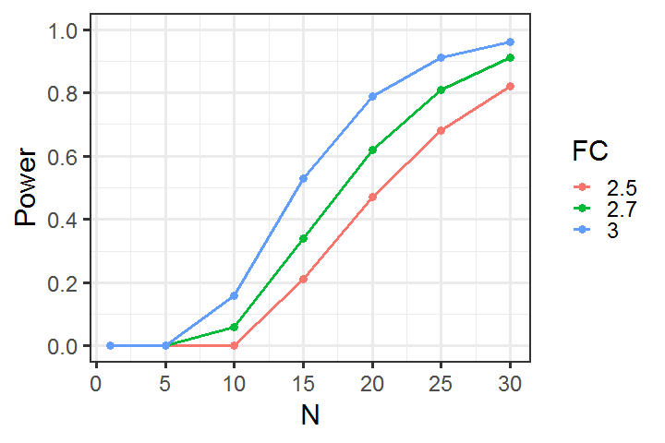
Genomic-type endpoints: power analysis
Example: RNA-Seq power calculations
We will obtain n=25 Pt-S and n=25 Pt-R tumors. Power analysis is based on the two-group comparison of Pt-S and Pt-R RNA-Seq data based on an exact test assuming negative binomial distribution, using RnaSeqSampleSize¹ package in R/Bioconductor.
We assume that the read counts in our ovarian cancer samples will have a similar distribution to the uterine (UCEC) cancer data in TCGA, where the median read count was 17.1 and the median dispersion was 0.58.
We also assume that the ratio of the geometric mean of normalization factors is 1, and that the total number of genes for testing is 10000 after normalization, with 1% of the genes (n=100) differentially expressed.
With n=25 samples per group we will have 81% power, controlling FDR=0.05, to detect a fold change FC=2.7.

Slide 11
Pilot studies
Pilot trial:
  a small scale study to test the methods and procedures to be used on a larger scale
Common goals of pilot studies¹:
  obtain preliminary data to inform the design of the subsequent larger study (compliance rates, safety, SD estimates*)
  assess feasibility – “so as to avoid potentially disastrous consequences of embarking on a large study” (recruitment, compliance, logistics)
  * variance may be underestimated
¹ Thabane et al, BMC Medical Research Methodology (2010)

Slide 12
Challenges and Misconceptions
Most pilot projects are poorly designed
  no clear feasibility objectives
  no clear analytic plans
  no criteria for success of feasibility
Examples of poor pilot study design justifications:
  So-and-so did a similar study with 6 patients and got statistical significance, and we are doing 12, so we are Ok
  We did a similar pilot before (and it was published)
  I only have funding for 10 subjects
  This is just a student project

Slide 13
Designing a pilot trial
Still need a proper statistical design
Pilot study design should include at least the following:
  rationale for conducting a pilot study in the context of the "real" larger study
  primary endpoints (feasibility/compliance, estimates to be obtained)
  sample size justification (usually focusing on estimation, not testing)
  "end-product" definition - how will the go/no-go decision be made for the larger study

Slide 14
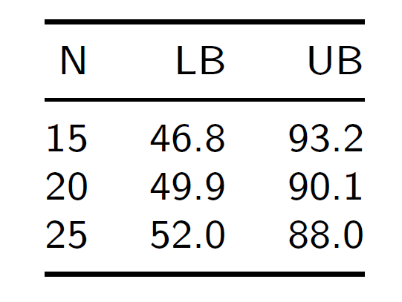
Designing a pilot trial: sample size
Example
Work with the PI to define the “success” criteria
  e.g. for enrollment or compliance
Base sample size on obtaining reasonably precise estimates
  e.g. for enrollment or compliance
Success endpoint: e.g. “the main trial will be considered feasible if >50% of screened and eligible subjects agree to participate”
  Expect that ≥70% would agree to participate
  Calculate 95% CI for the proportion for a range of sample sizes (could also do one-sided)
  With n=25 the LB > 50%, so choose n=25

Slide 15

Pilot studies reference

Slide 16
Clinical Trials
Clinical trial (NIH definition):
  A research study in which one or more human subjects are prospectively assigned to one or more interventions (which may include placebo or other control) to evaluate the effects of those interventions on health-related biomedical or behavioral outcomes.
Pilot Trials
  Obtain preliminary data for larger studies; work out logistical details
Phase I
  Dose finding – recommended Phase II dose (RP2D); safety
Phase II
  Demonstrate activity; additional safety; decide whether to go on to Phase III
Phase III
  Definitive testing of a treatment vs. control (confirmatory trial)

Slide 17
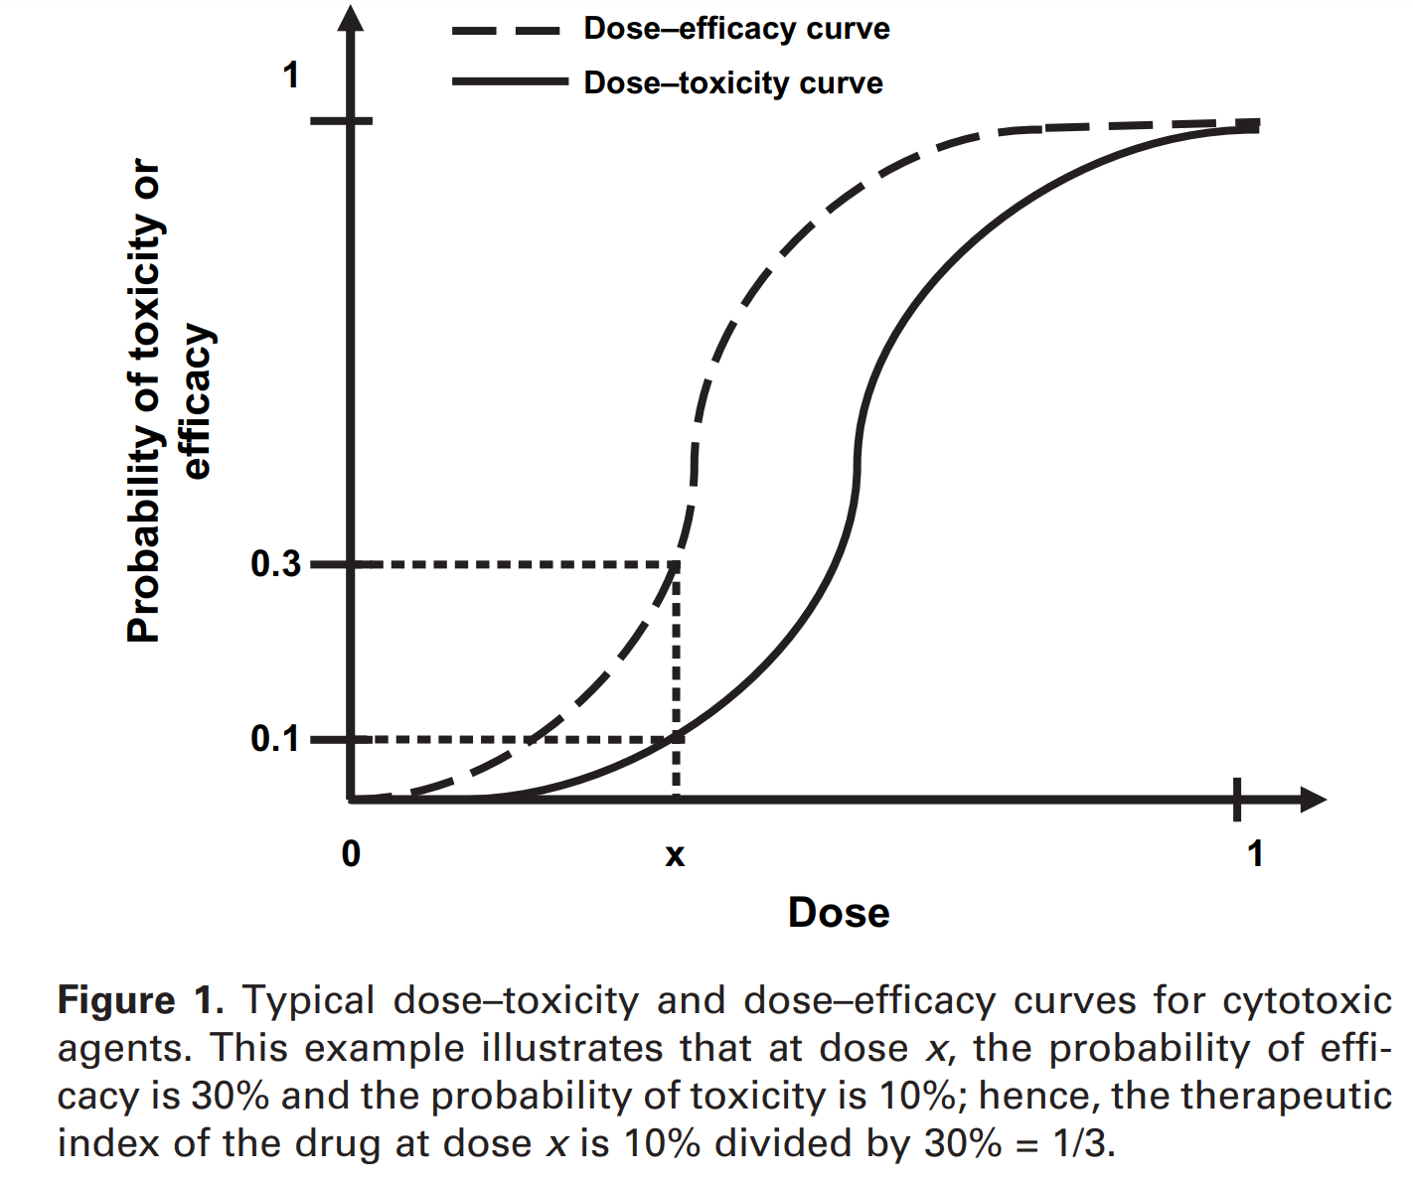
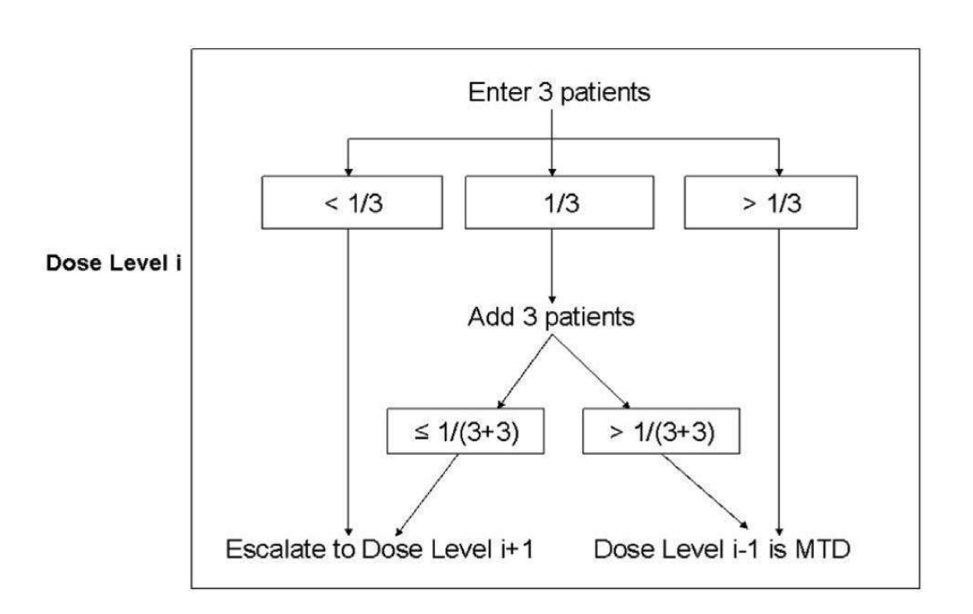
Phase I trials
Dose escalation: Dose 1, Dose 2, Dose 3, etc
Want to find maximum tolerated dose (MTD)
  Assumption: higher doses are better, but more toxic
“3+3” – the most common design
  (+) Simple to use
  (-) Few patients treated at or near recommended dose
  (-) May underestimate the MTD
Dose expansion cohort (DEC) or multiple expansion cohorts
  Better evaluation of toxicity at the MTD
  Preliminary efficacy (e.g. estimate response)
  Usually 15-30 subjects, including MTD from escalation
  Need sample size justification
    Can be based on response rate
    Can be based on CI estimates (e.g. as in pilot studies)

Slide 18
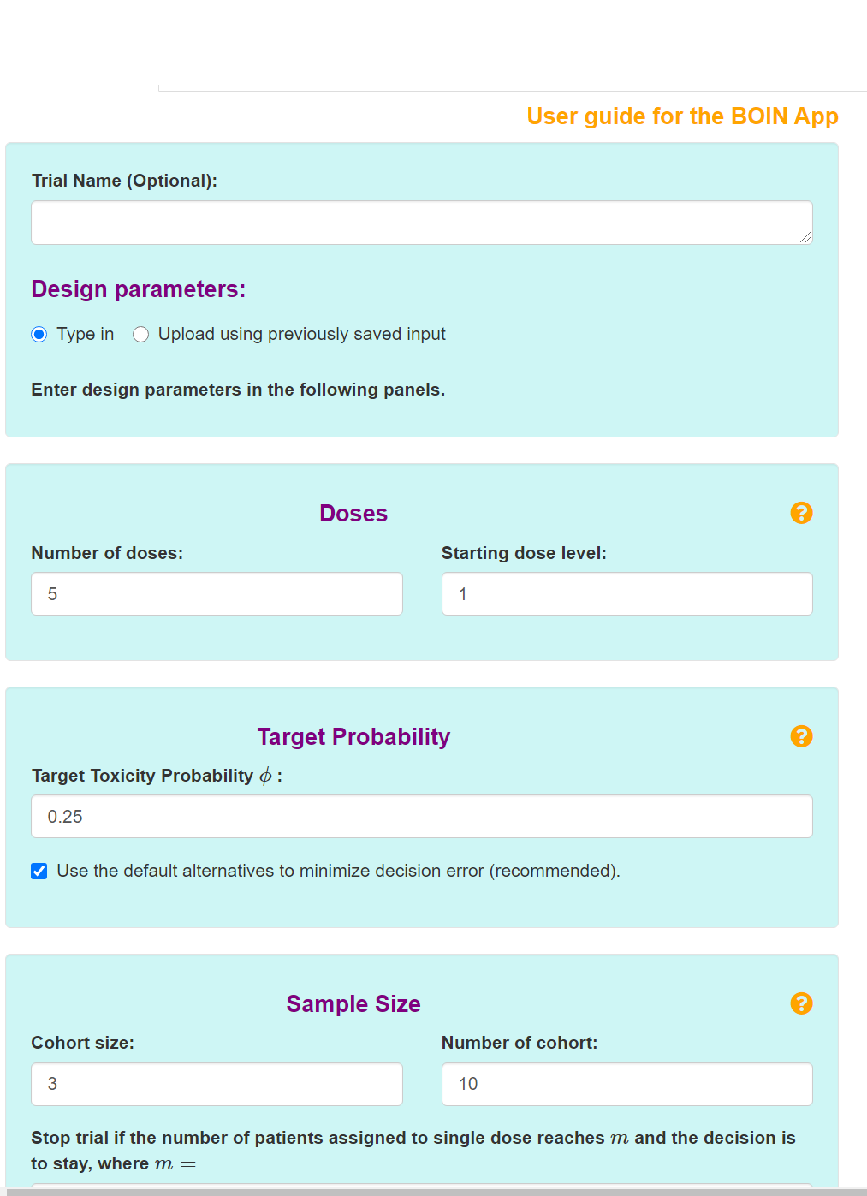
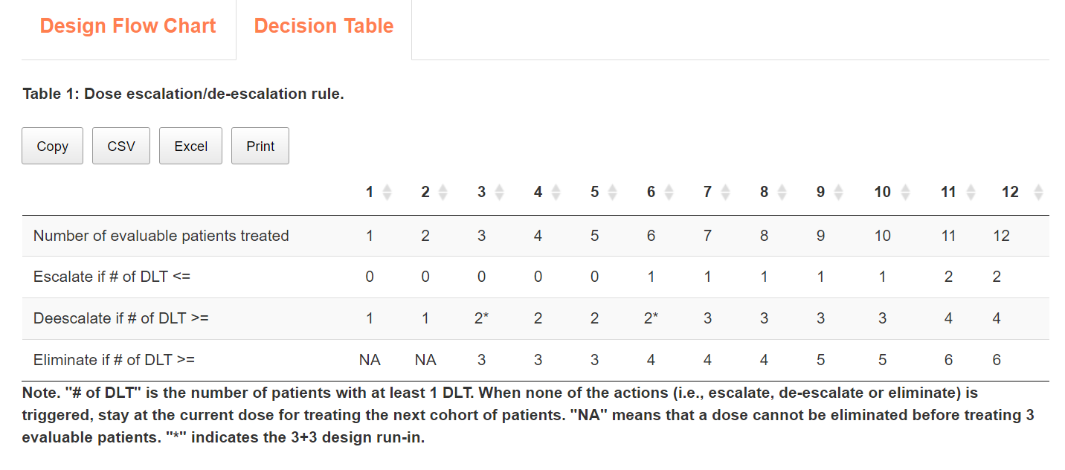
Alternatives to “3+3”
trialdesign.org (MD Anderson)
Continuous reassessment method (CRM) - 1990
  Model-based
  Logistics are complex due to frequent model-re-estimation; never picked up
Bayesian designs: www.trialdesign.org
  Keyboard, Bayesian Optimal Interval (BOIN), Time-to-event BOIN (TITE-BOIN)
BOIN
  easy to implement (provides rules table)
  flexible target toxicity rate and cohort size
  more likely to correctly select MTD
  allocates more patients to the MTD

Slide 19
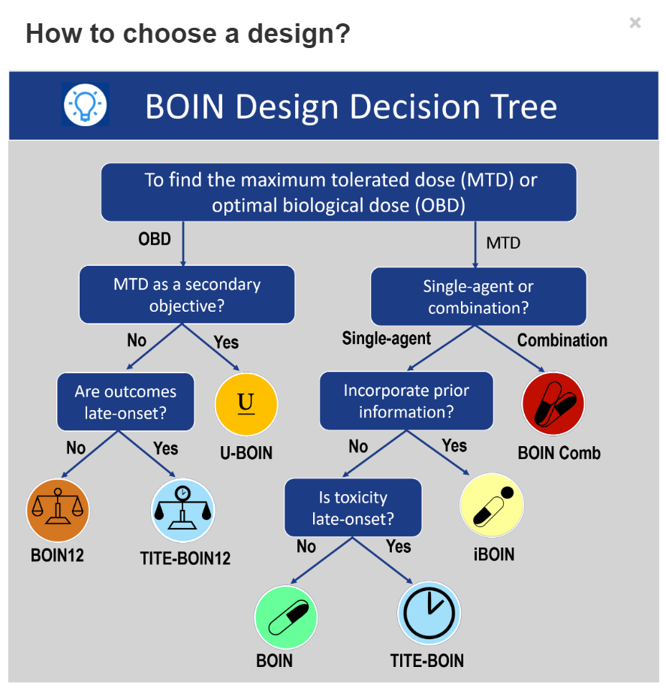
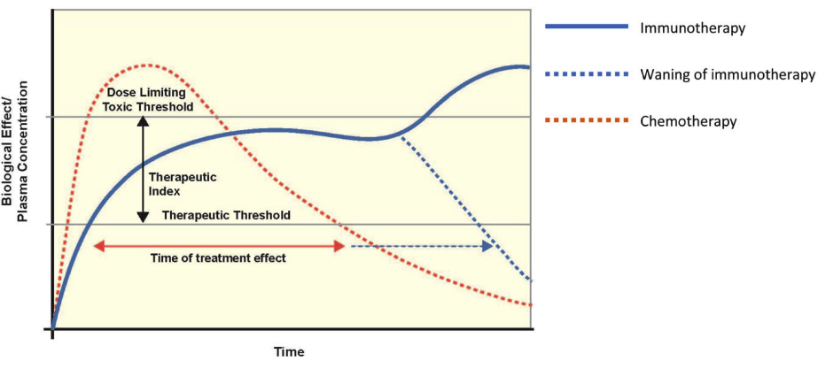
Immunotherapy – different paradigm
Immunotherapies
  "monoclonal antibodies, with modest dose-response relationship once receptor saturation has been achieved; can have prolonged biological effects even after discontinuation of treatment"
  Toxicities may be unpredictable: timing, severity, and duration
  Delayed onset and prolonged duration
  Standard escalation methods don't capture true toxicity profile
  Low DLT rates, may not reach MTD
  Defining optimal phase II dose is challenging
Alternative: Optimal biologically active dose (OBD)
  Wages and Tait (2015) https://uvatrapps.shinyapps.io/wtdesign/
  U-BOIN, BOIN12 and TITE-BOIN12 (www.trialdesign.org)

Slide 20
Phase II trials
Primary endpoint: usually response (ORR=CR/PR) or progression-free survival (PFS)
Single arm trials
  (+) Smaller sample size (usually < 60 patients)
  (-) Bias (historic controls, eligibility criteria, time trends)
  (-) Combination treatments: can’t determine contributions of each component
Randomized designs
  (+) Eliminates biases via randomization (and blinding)
  (+) Valid comparisons
  (-) Large sample size (up to 4 times as many)
ORR: Simon’s single arm two-stage design - very common but often criticized
PFS: one-sample logrank test can be used
  Better power than using the binary outcome of fixed-time PFS rate (e.g. 6-month PFS rate)
  Difficult to plan interim analyses

Slide 21
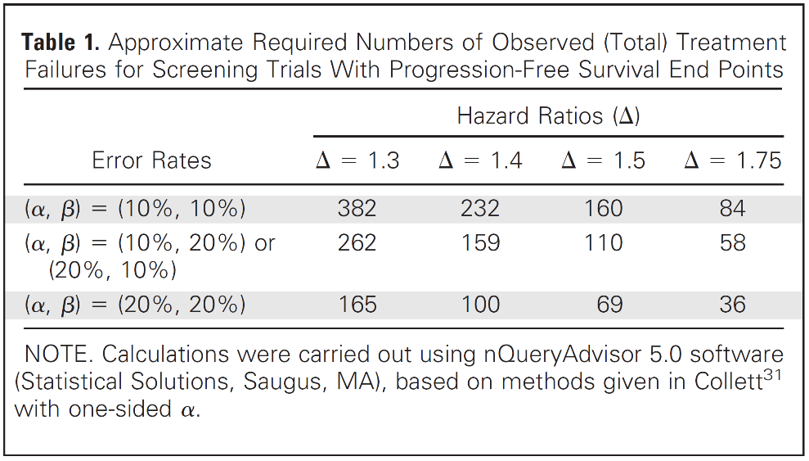
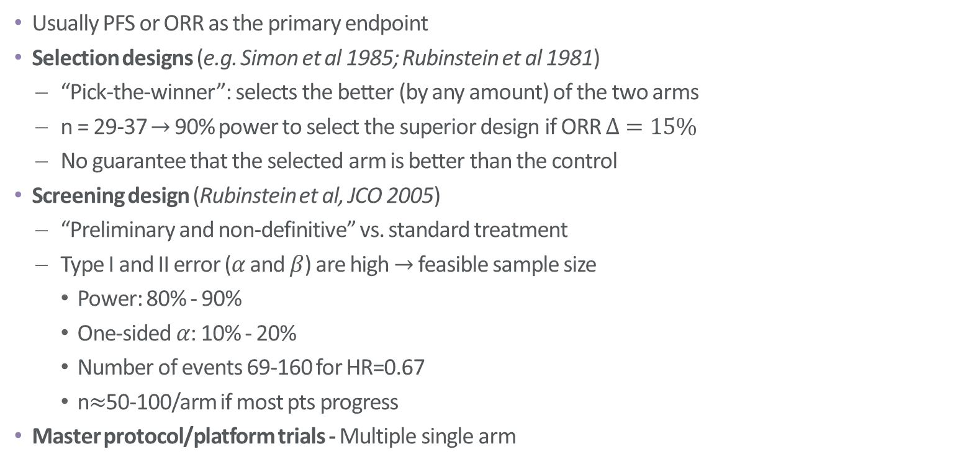
Randomized Phase II trials
Design Issues of Randomized Phase II Trials and a Proposal for Phase II Screening Trials (Rubinstein et al, JCO 2005)
Usually PFS or ORR as the primary endpoint
Selection designs (e.g. Simon et al 1985; Rubinstein et al 1981)
  “Pick-the-winner”: selects the better (by any amount) of the two arms
  n = 29-37 $→$ 90% power to select the superior design if ORR $Δ=15\%$
  No guarantee that the selected arm is better than the control
Screening design (Rubinstein et al, JCO 2005)
  “Preliminary and non-definitive” vs. standard treatment
  Type I and II error ($α$ and $β$) are high $→$ feasible sample size
    Power: 80% - 90%
    One-sided $α$: 10% - 20%
    Number of events 69-160 for HR=0.67
    n$≈$50-100/arm if most pts progress
Master protocol/platform trials - Multiple single arm

Slide 22
Biomarkers in clinical trials
Integral
  Inherent in the study design, performed in real time for eligibility or stratification
Integrated
  Used to test specific hypotheses in the study, not integral to study design
Prognostic
  Associated with disease prognosis regardless of treatment type (e.g. CA-125 or PSA)
Predictive
  Different prognostic ability depending on treatment (e.g. HRD for PARPi) - interaction
Credentials
  Very strong: strong evidence of benefit in M+ only (enrichment design)
  Strong: evidence of benefit in M+, but cannot rule out benefit in M-
  Weak: treatment is expected to benefit both M+ and M-

Slide 23
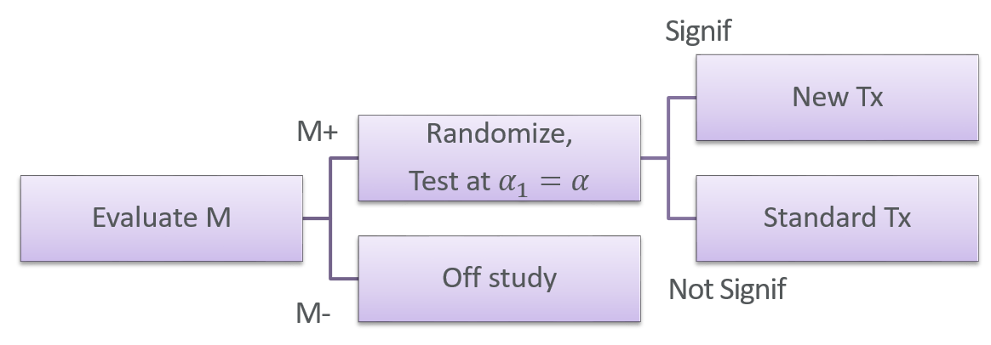
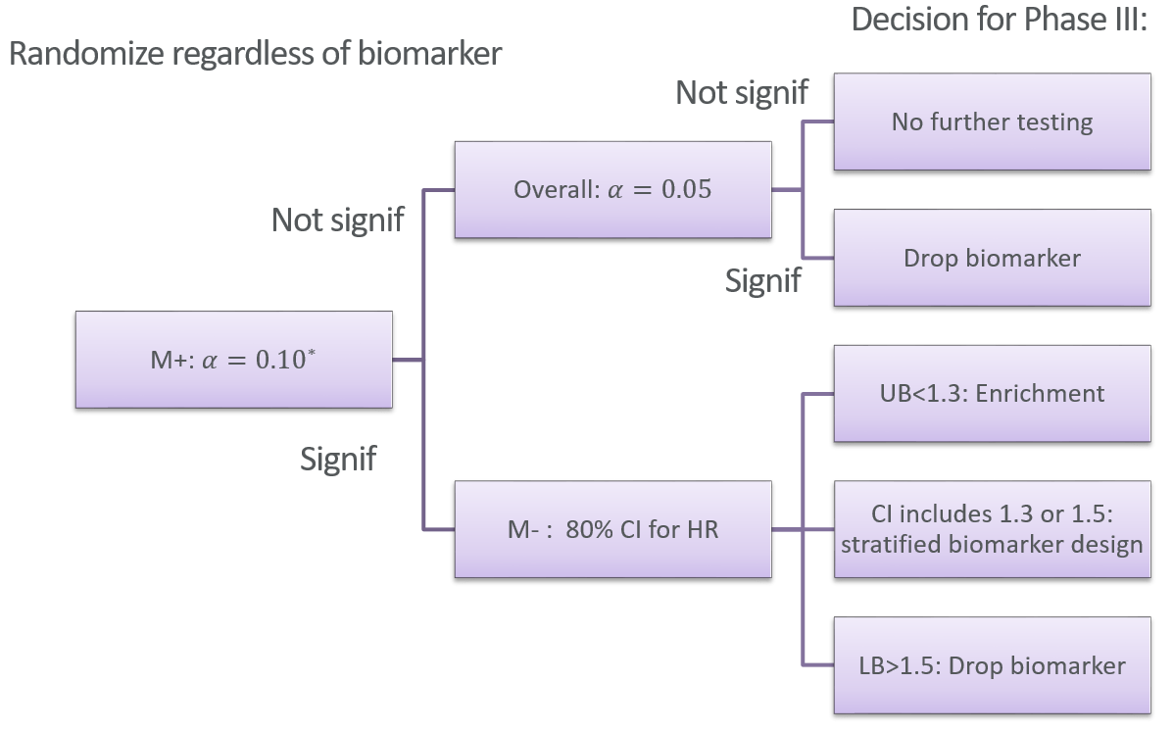
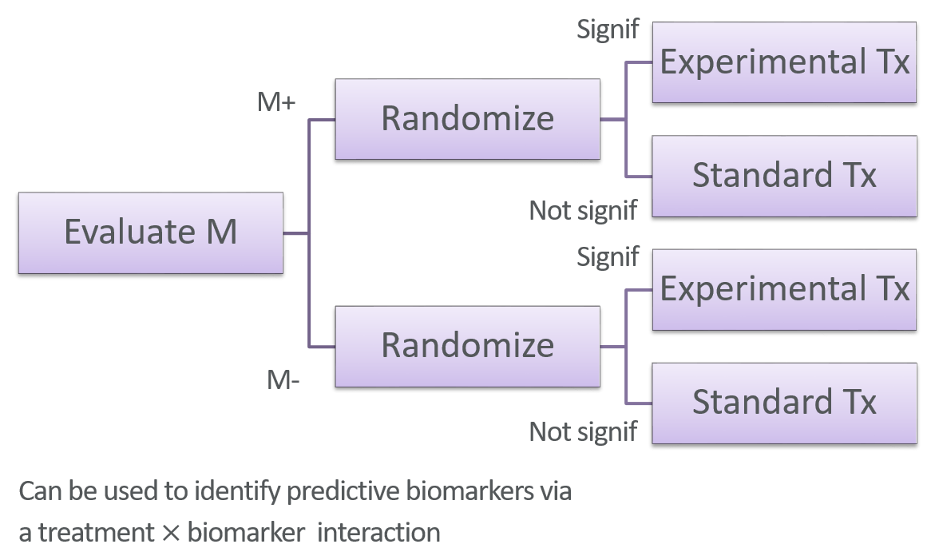
Goals of Phase II designs with biomarkers
Phase III designs
Phase II goals: Phase III go/no go decision, and inform Phase III design:
  Biomarker-enrichment design
  Biomarker-stratified design
  Drop biomarker (standard Phase III design)
  Do not conduct Phase III
Biomarker-enrichment design
Biomarker-ratified design

Slide 24
Summary
Describe design and the outcomes in the analysis plan
Match a statistical analysis plan for each experiment, hypothesis and outcome
  Can group similar analysis types, if appropriate
Start from simpler analyses as appropriate, followed by additional more complex analysis methods
State all assumptions for analysis and power calculations, provide rationale for why a particular method is used
Know your audience:
  Clinicians who may not know statistics
  Statisticians would want enough detail
Power calculations:
  Need one for each main type of analysis, and for all primary endpoints
  Don’t use generic calculations (e.g. only standardized effect size), connect effect size to preliminary data
  Simplify the tests and design for power analysis: e.g. 2-group comparison even if >2 groups; two-sample t-test for tumor growth instead of mixed models
  Provide enough detail about assumptions so that power calculations can be reproduced

Slide 25
Thank you.
Questions?

