Slide 1
Comparing Treatment Effects under Cox Non-proportional Hazard Models
Edward F. Vonesh, Ph.D.
Adjunct Professor of Preventive Medicine,
Northwestern University, Chicago, IL
June 15, 2021

Slide 2
Outline
  Introduction and Goals
    Prognostic versus Prevailing Evidence
    Appropriate Statistical Methods
  Key Concepts and Their Meaning
    Covariates
    Review of Survival Function and Hazard Function
    The Cumulative Hazard Function
    Hazard Ratios and Cumulative Hazard Ratios
    Cox Models for Survival Analysis
  Examples
    USRDS and KPSC registry data comparing survival of ESRD patients on Peritoneal Dialysis vs. Hemodialysis

Slide 3
Introduction and Goals
Prognostic vs. Prevailing Evidence in Survival Analysis
Prognostic evidence
  Goal: Provide prognostic evidence of a benefit between two treatments on the basis of the initial treatment a patient may choose, be assigned to, or be randomized to.
  Example: What is the expected or predicted survival among patients with end-stage renal disease (ESRD) who start dialysis on peritoneal dialysis (PD) versus in-center hemodialysis (HD)?
  This question is based on the intent-to-treat principle.

Slide 4
Prognostic vs. Prevailing Evidence in Survival Analysis
Prevailing evidence
  Goal: Provide conditional evidence of a prevailing (current) benefit between two treatments on the basis of the treatment a patient is currently receiving
  Example: What is the risk of death for ESRD patients who are currently alive at time t and being treated with PD versus HD?
  This question is conditional on patients surviving up to time t and is based on the as-treated principle.

Slide 5
Appropriate Statistical Methods
Prognostic evidence: ← Focus of this talk
  Cox models with only time-independent covariates
    Inference may be based on
      Proportional hazards models,
        Constant Hazard Ratios (HR)
        Survival Curves
      Non-proportional Hazards Models
        Time-dependent Hazard Ratios (HR(t))
        Cumulative Hazard Ratios (CHR(t)) ← Focus
        Survival Curves
Prevailing evidence:
  Cox models with time-dependent covariates
    Inference is restricted to time-dependent Hazard Ratios

Slide 6
Concepts and Their Meaning
Covariates (or Independent Risk Factors)
Variables (risk factors, confounding variables) that one wishes to compare and/or control for when comparing outcomes among patients
  Time-independent covariates
  Time-dependent covariates
    internal or endogenous (covariates that require the subject to be alive in order to be measured; e.g., blood pressure over time as a risk factor)
    external or exogenous (covariates external to the subject; e.g., air-pollution over time as a risk factor)

Slide 7
Time-independent Covariates
Variables or risk factors measured at baseline and held fixed throughout the course of follow-up
  Initial treatment group (PD versus HD)
  Baseline demographics (age, gender, comorbidity)
  Baseline lab values (Serum Albumin, Hgb, etc.)
These covariates can be used in a prognostic fashion to predict and compare both the adjusted risk of death and adjusted patient survival between treatments on the basis of the initial patient characteristics

Slide 8
Time-dependent Covariates
Variables or risk factors measured at baseline and at various times during the course of follow-up
  Current treatment group (PD versus HD) at time t
  Current comorbidity at time t
  Current lab values (Serum Albumin, Hgb, etc.) at time t
With GREAT care these covariates may be used to compare the current adjusted risk of death between treatment groups based on what treatment a patient is currently receiving.
These covariates cannot be used to estimate survival (i.e., we cannot use the future to predict the past)
  Exceptions to this occurs only for time-dependent covariates that are external to the subjects.

Slide 9
Adjusting for Time-Dependent Covariates
WARNING, WARNING!!!!!!
Common Mistakes with Time-Dependent Covariates
  Adjusting for a covariate which is itself affected by the treatment groups being compared
    Example: Kidney function measured by GFR is measured every 6 months and one adjusts for GFR when comparing PD and HD
    Better GFR is associated with better survival
    PD has been shown to preserve GFR better than HD
    Problem: Adjusting for GFR adjusts out a survival benefit of PD
    Solution: One solution is to use a marginal structural model
  Using the future to predict the past
    Extreme Example: One uses age at the end of follow-up as a predictor of survival.
    Conclusion: Old age is associated with better survival

Slide 10
Time-dependent Covariates
WARNING, WARNING!!!!!!
Example 1: CHOICE Study (Ann Int Med 143:174-183, 2005)
The CHOICE Study measured C-reactive protein (CRP) a median of 5 months after starting dialysis.
The authors compare PD and HD survival adjusting for CRP treating it as a baseline covariate.
  Question 1: Does PD or HD affect CRP?
  Question 2: How do we compare 3 month survival adjusting for a CRP value that has yet to be measured?

Slide 11
Example 1: CRP measured 5 months after baseline
Rule: CAN NOT use the future to predict the past
x
PD
x
x
How do I use these values to predict adjusted 3-month survival? The probability of survival is 1.0 at these times!
HD
x
x
Jan, 2004 March, 2004 June, 2004

Slide 12
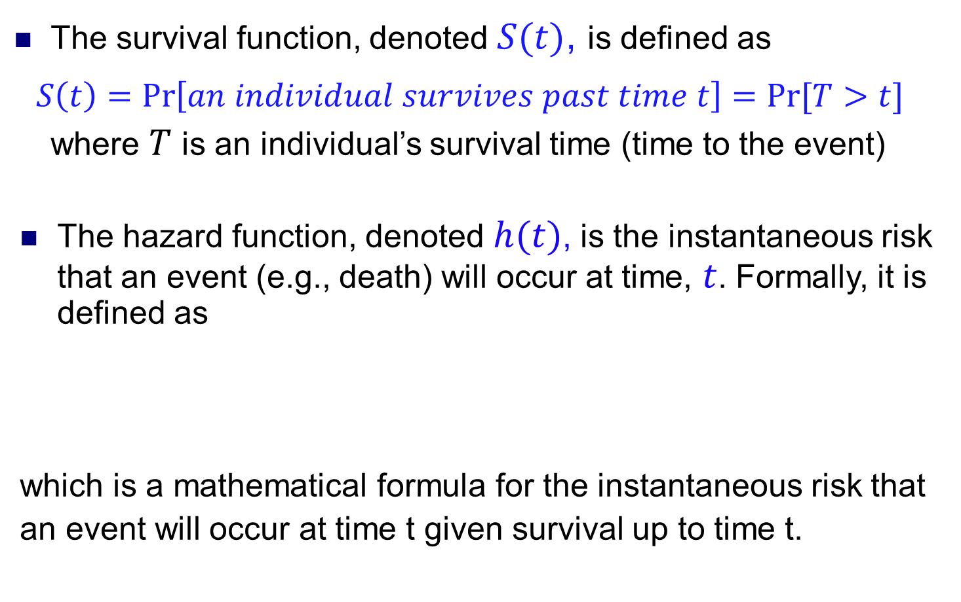
REVIEW: Survival and Hazard Functions
The survival function, denoted $S(t)$, is defined as
$$S\left(t\right)=\operatorname{Pr}\left[an individual survives past time t\right]=Pr⁡[T>t]$$
where $T$ is an individual’s survival time (time to the event)
The hazard function, denoted $h(t)$, is the instantaneous risk that an event (e.g., death) will occur at time, $t$. Formally, it is defined as
which is a mathematical formula for the instantaneous risk that
an event will occur at time t given survival up to time t.

Slide 13
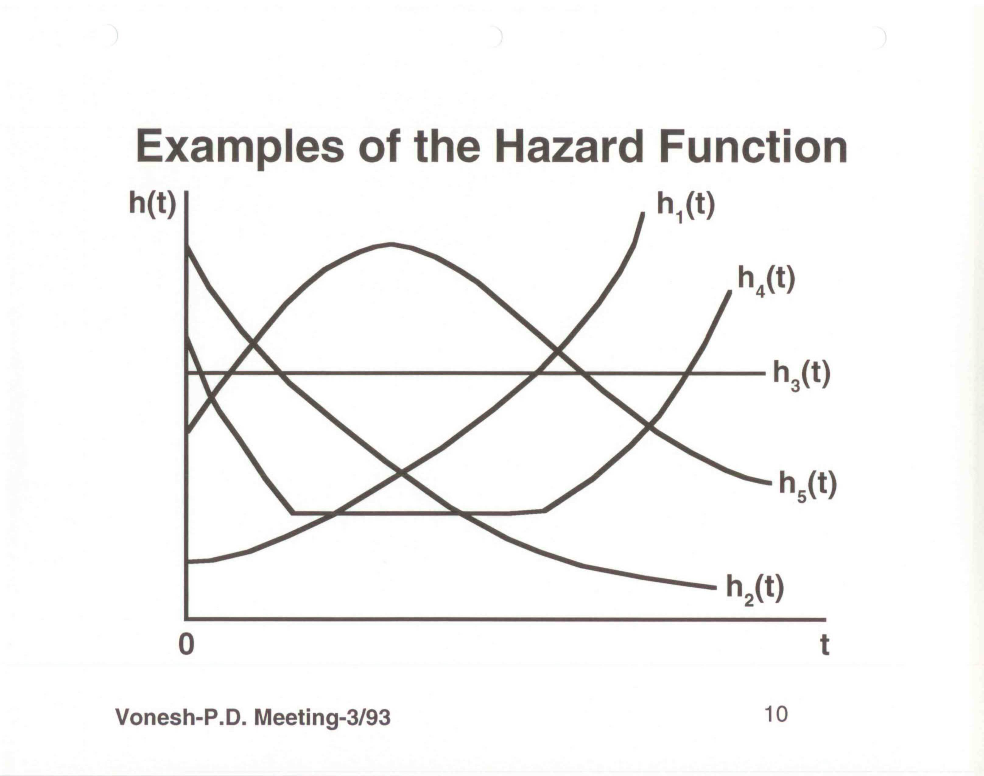
Example Hazard Functions Associated with Mortality
h₁(t) = Increasing hazard rate associated with leukemia & patients who fail to respond to treatment
h₂(t) = Decreasing hazard rate associated with certain surgical procedures
h₃(t) = Constant hazard rate (healthy subjects age 20-50 reflecting accidental death)
h₄(t) = “Bathtub” hazard rate associated with overall life expectancy (early infant mortality, accidental death, increasing mortality with age
h₅(t) = Increasing-decreasing hazard rate associated with patients with tuberculosis whose risk initially increases but then decreases with treatment
Source: Lee, E.T. (1980). Statistical Methods for Survival Data Analysis, Wadsworth Inc., Belmont, CA

Slide 14
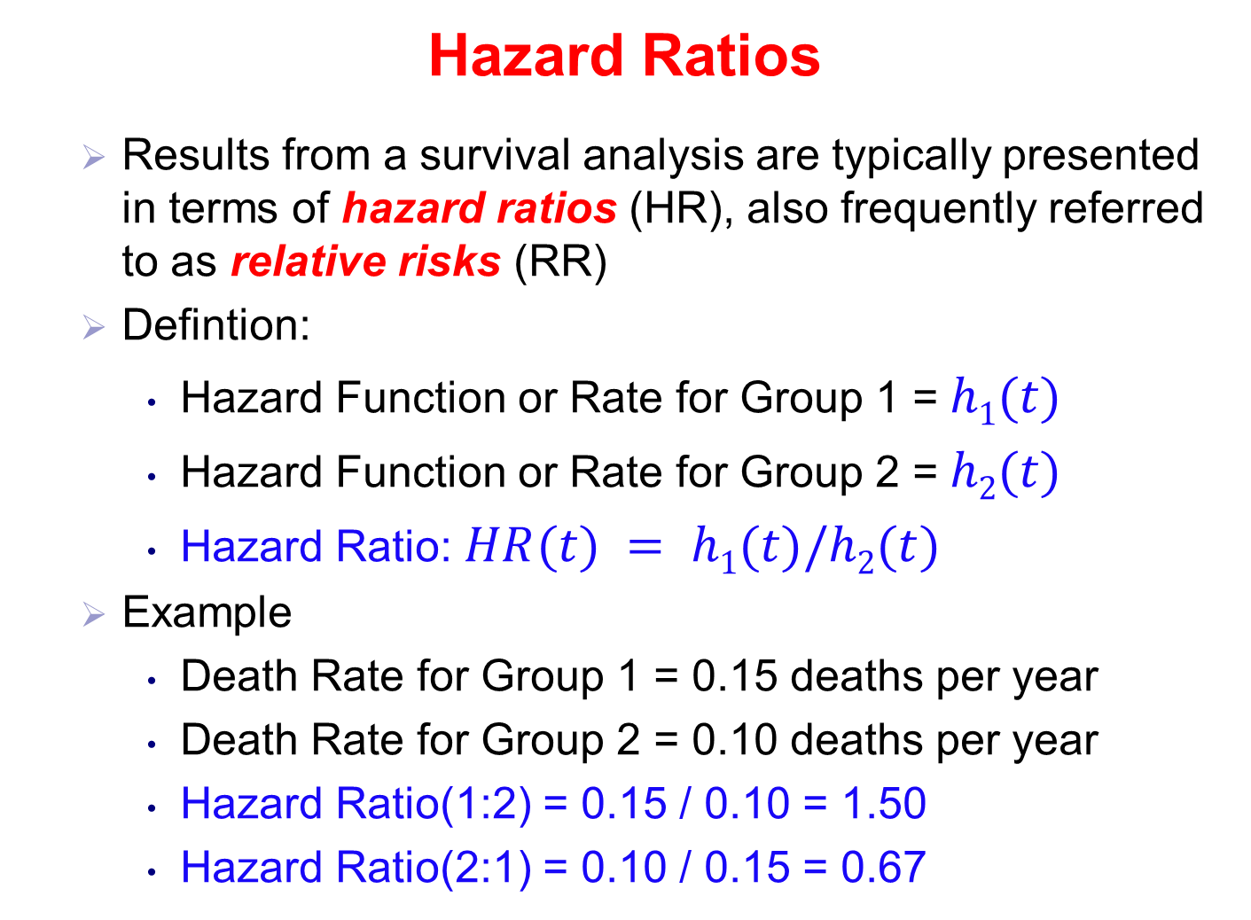
Hazard Ratios
  Results from a survival analysis are typically presented in terms of hazard ratios (HR), also frequently referred to as relative risks (RR)
  Defintion:
    Hazard Function or Rate for Group 1 = $h1(t)$
    Hazard Function or Rate for Group 2 = $h2(t)$
    Hazard Ratio: $HR(t) = h1(t)/h2(t)$
  Example
    Death Rate for Group 1 = 0.15 deaths per year
    Death Rate for Group 2 = 0.10 deaths per year
    Hazard Ratio(1:2) = 0.15 / 0.10 = 1.50
    Hazard Ratio(2:1) = 0.10 / 0.15 = 0.67
Same

Slide 15
Hazard Ratios
  Proportional hazards between two groups means the hazard ratio is constant over time, i.e.,
    which means we can use a Cox proportional hazards model to compare the two groups

Slide 16
Hazard Ratios
  Non-proportional hazards between two groups means the hazard ratio varies in some fashion over time, i.e.,
    which means we have time-dependent hazard ratios and must use a Cox non-proportional hazards model to compare the two groups

Slide 17
Example: USRDS 2002-2004
Unadjusted Hazard (Mortality) Rates and Hazard Ratios
 | PD |  |  | HD |  |  | HR
Monthly Interval [t₁, t₂) | Total Deaths | Total Months at Risk | Hazard Rate h_{PD}(t₁) | Total Deaths | Total Months at Risk | Hazard Rate h_{HD}(t₁) | Hazard Ratio (PD:HD)
0-6 | 1397 | 112541 | 0.0124 | 32066 | 1281860 | 0.0250 | 0.496
6-12 | 1350 | 98169 | 0.0138 | 20963 | 1108082 | 0.0189 | 0.730
12-18 | 1262 | 84937 | 0.0149 | 17105 | 972212 | 0.0176 | 0.847
18-24 | 1122 | 73053 | 0.0154 | 15074 | 853341 | 0.0177 | 0.870
24-30 | 1022 | 62564 | 0.0163 | 13326 | 749204 | 0.0178 | 0.916
30-36 | 755 | 49621 | 0.0152 | 10591 | 602975 | 0.0176 | 0.864
0-36 | 6908 | 480885 | 0.0144 | 109125 | 5567674 | 0.0196 | 0.735
If we assume a constant hazard rate over the entire three year period for both PD and HD, we end up with proportional hazards model with HR(PD:HD)= 0.735
The piecewise 6-month interval hazard ratios are those obtained from a non-proportional hazards exponential model with piecewise constant hazard rates
The data suggests that a non-proportional hazards model is more appropriate

Slide 18
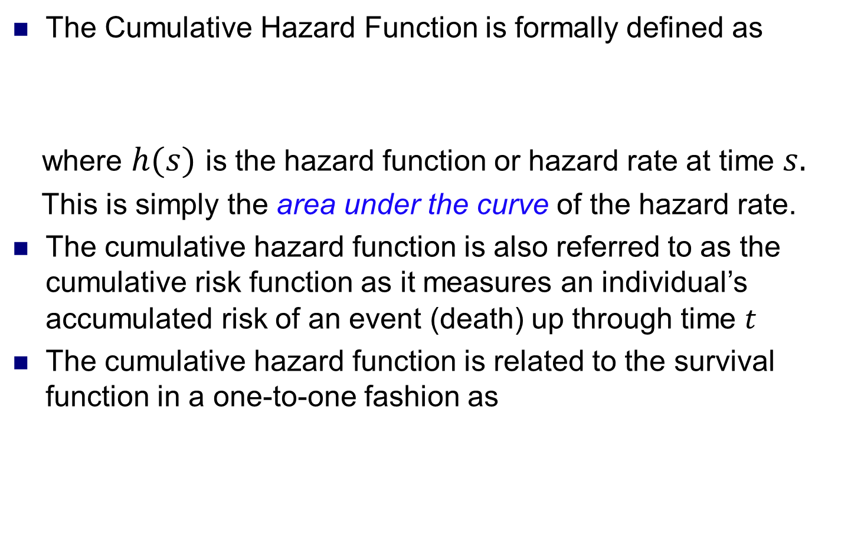
Cumulative Hazard Function
The Cumulative Hazard Function is formally defined as
where $h(s)$ is the hazard function or hazard rate at time $s.$
This is simply the area under the curve of the hazard rate.
The cumulative hazard function is also referred to as the cumulative risk function as it measures an individual’s accumulated risk of an event (death) up through time $t$
The cumulative hazard function is related to the survival function in a one-to-one fashion as

Slide 19
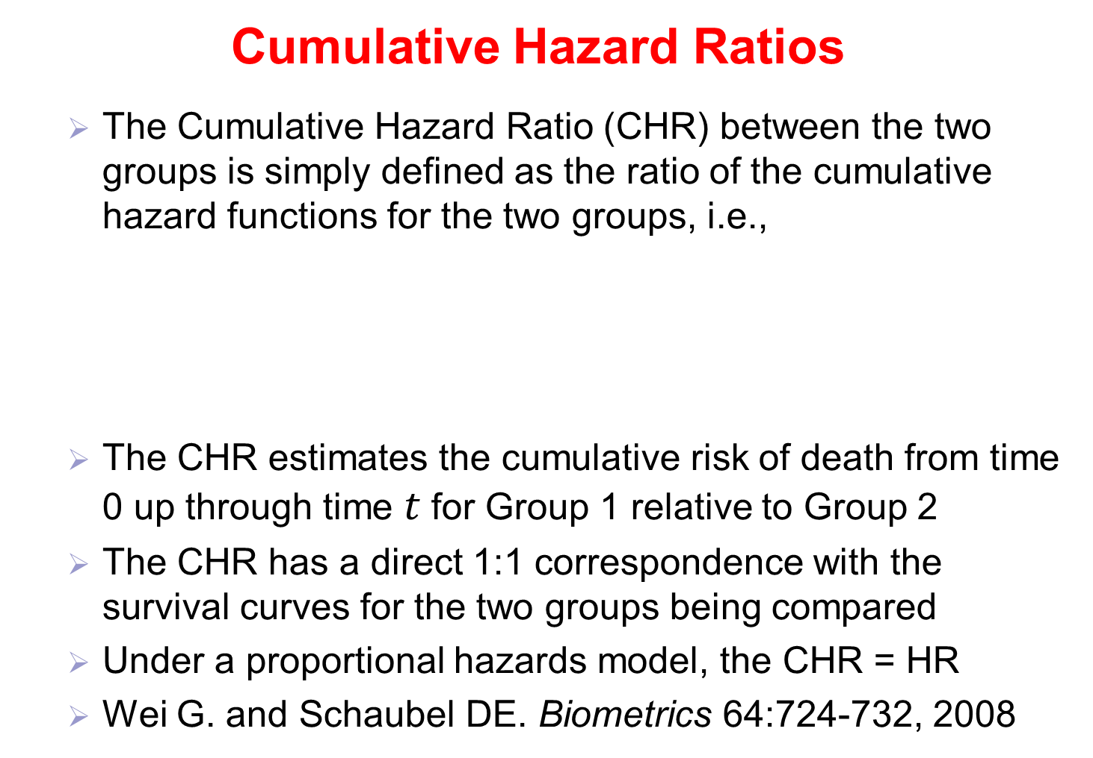
Cumulative Hazard Ratios
  The Cumulative Hazard Ratio (CHR) between the two groups is simply defined as the ratio of the cumulative hazard functions for the two groups, i.e.,
  The CHR estimates the cumulative risk of death from time 0 up through time $t$for Group 1 relative to Group 2
  The CHR has a direct 1:1 correspondence with the survival curves for the two groups being compared
  Under a proportional hazards model, the CHR = HR
  Wei G. and Schaubel DE. Biometrics 64:724-732, 2008

Slide 20
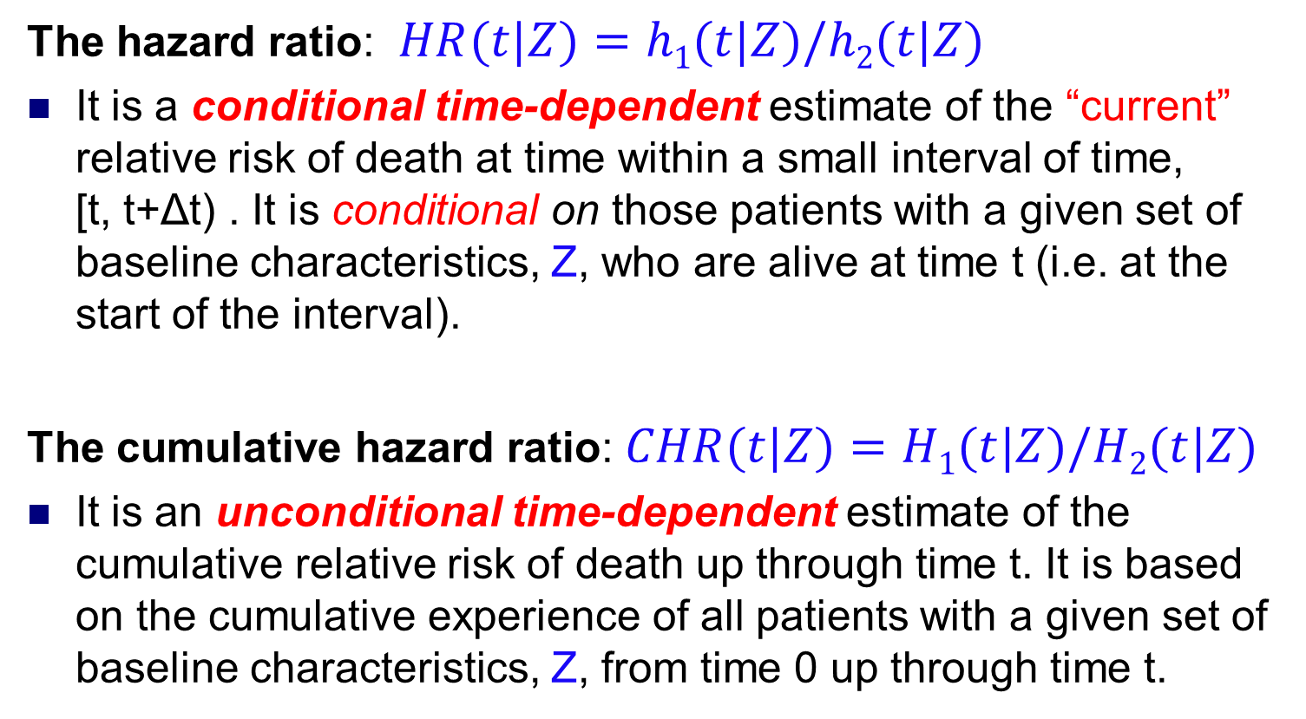
Adjusted Time-Dependent Hazard Ratios versus
Adjusted Cumulative Hazard Ratios
The hazard ratio: $HR(t|Z)=h1(t|Z)/h2(t|Z)$
It is a conditional time-dependent estimate of the “current” relative risk of death at time within a small interval of time, [t, t+Δt) . It is conditional on those patients with a given set of baseline characteristics, Z, who are alive at time t (i.e. at the start of the interval).
The cumulative hazard ratio: $CHR(t|Z)=H1(t|Z)/H2(t|Z)$
It is an unconditional time-dependent estimate of the cumulative relative risk of death up through time t. It is based on the cumulative experience of all patients with a given set of baseline characteristics, Z, from time 0 up through time t.

Slide 21
Example: USRDS 2002-2004
Hazard Ratios versus Cumulative Hazard Ratios
 | PD |  | HD |  | Relative Risk Estimates
Monthly Interval [t₁ , t₂) | Hazard Rate h_{PD}(t₁) | Cumulative Hazard Rate H_{PD}(t₂) | Hazard Rate h_{HD}(t₁) | CumulativeHazard Rate H_{HD}(t₂) | Hazard Ratio (PD:HD) | Cumulative Hazard Ratio (PD:HD)
0-6 | 0.0124 | 0.0744 | 0.0250 | 0.1500 | 0.496 | 0.496
6-12 | 0.0138 | 0.1572 | 0.0189 | 0.2634 | 0.730 | 0.597
12-18 | 0.0149 | 0.2466 | 0.0176 | 0.3690 | 0.847 | 0.668
18-24 | 0.0154 | 0.3390 | 0.0177 | 0.4752 | 0.870 | 0.713
24-30 | 0.0163 | 0.4368 | 0.0178 | 0.5820 | 0.916 | 0.751
30-36 | 0.0152 | 0.5280 | 0.0176 | 0.6876 | 0.864 | 0.768
Example: The cumulative hazard rate for PD through the end of the first 6 months is simply H_{PD}(6) = h_{PD}(t) × 6 = 0.0124 × 6 = 0.0744.
One then keeps accruing these cumulated risks across intervals

Slide 22
Cox Models For Comparing PD to HD
Cox proportional hazards (PH) model
  Assumes a common underlying baseline hazard function for all patients but makes no assumption about the shape of this baseline hazard function
  Assumes the hazard ratio (HR) for comparing PD to HD is constant over the entire interval of follow-up
  The model allows one to adjust for other baseline risk factors which are also assumed to satisfy the proportional hazards assumption (i.e., the hazard ratios for other risk factors are also constant over time)

Slide 23
Cox Models For Comparing PD to HD
Piecewise Cox Non-proportional (NPH) Model
  Assumes a common underlying baseline hazard function for all patients but makes no assumptions about the shape of this baseline hazard function
  Assumes the hazard ratio for comparing PD to HD is piecewise constant within non-overlapping intervals of follow-up (e.g., 6-month intervals [0, 6), [6, 12), etc.)
  The hazard ratio may differ from interval to interval yielding time-dependent hazard ratios
  The model allows one to adjust for other baseline risk factors which are assumed to satisfy the proportional hazards assumption across the intervals.

Slide 24
Cox Models For Comparing PD to HD
A Stratified Cox Proportional Hazards Model
  Stratifies patients into two groups (PD versus HD)
  Assumes a different underlying baseline hazard function for PD patients versus HD patients but makes no assumptions about the shape of these two baseline hazard functions
  Treatments effects from a stratified Cox model are compared using the cumulative hazard ratio (CHR)
  The model allows one to adjust for other baseline risk factors with each risk factor assumed to have the same effect across both stratum and each risk factor satisfies the proportional hazards assumption.

Slide 25
Examples
USRDS Incident ESRD Patients: 2002-2004
  N = 252,961 incident patients started dialysis therapy in the United States, survived at least 90 days, and had a Medical Evidence form 2728 submitted
  Initial Modality
    HD: N = 233,082
    PD: N = 19,879.
  Baseline Characteristics (Risk Factors/Covariates)
    Demographics (Gender, Age, Race)
    Clinical (Cause of ESRD, Comorbidity)
    Lab Values (Albumin, Hgb, eGFR, etc.)
  The incident PD patients were younger, more likely to be white, and less likely to have other co-morbidities.

Slide 26
USRDS: Select Baseline Comparisons
 | HD (n=233,082) | PD (n=19,879) | p Value
Gender, % male | 54 | 55 | 0.50
Race, % Whites Blacks Asians Others | 62 31 4 3 | 72 21 5 3 | <0.0001
Cause of ESRD, % Diabetes Hypertension Glomerulonephritis Others | 47 29 8 16 | 45 24 14 17 | <0.0001
Comorbidty, % Cardiac arrest or dysrhythmia Cerebrovascular disease Congestive heart failure Ischemic heart disease or MI Peripheral Vascular Disease Diabetes (primary or secondary) | 7 9 32 27 14 53 | 5 7 20 21 10 48 | <0.0001 <0.0001 <0.0001 <0.0001 <0.0001 <0.0001
Age | 63 ± 15 | 58 ± 15 | <0.0001
Hemoglobin, g/dl | 10.0 ± 1.7 | 10.7 ± 1.7 | <0.0001
Serum albumin, g/dl | 3.1 ± 0.7 | 3.5 ± 0.7 | <0.0001
eGFR, ml/min/1.73 m² | 9.7 ± 4.6 | 9.6 ± 4.3 | 0.1825

Slide 27
Time-independent HR versus Time-dependent HR’s
Interval |  | Interval Cox NPH Model
( t1 , t2 ] |  | HR(PD:HD) and 95% CI
0 | 6 | 0.68 | (0.65-0.72)^{c}
6 | 12 | 0.99 | (0.93-1.04)^{NS}
12 | 18 | 1.14 | (1.08-1.21)^{c}
18 | 24 | 1.18 | (1.10-1.25)^{c}
24 | 30 | 1.24 | (1.17-1.33)^{c}
30 | 36 | 1.17 | (1.09-1.26)^{c}
36 | 42 | 1.20 | (1.10-1.30)^{c}
42 | 48 | 1.27 | (1.15-1.40)^{c}
48 | 54 | 1.19 | (1.04-1.36)^{b}
54 | 60 | 1.24 | (1.03-1.48)ª
0 | 60 | 1.03 | (1.004,1.05)ª
← Cox PH Model
p-values: ^{NS} not significant; (p>0.05); ª p<0.05; ^{b} p<0.01; ^{c} p<0.001

Slide 28
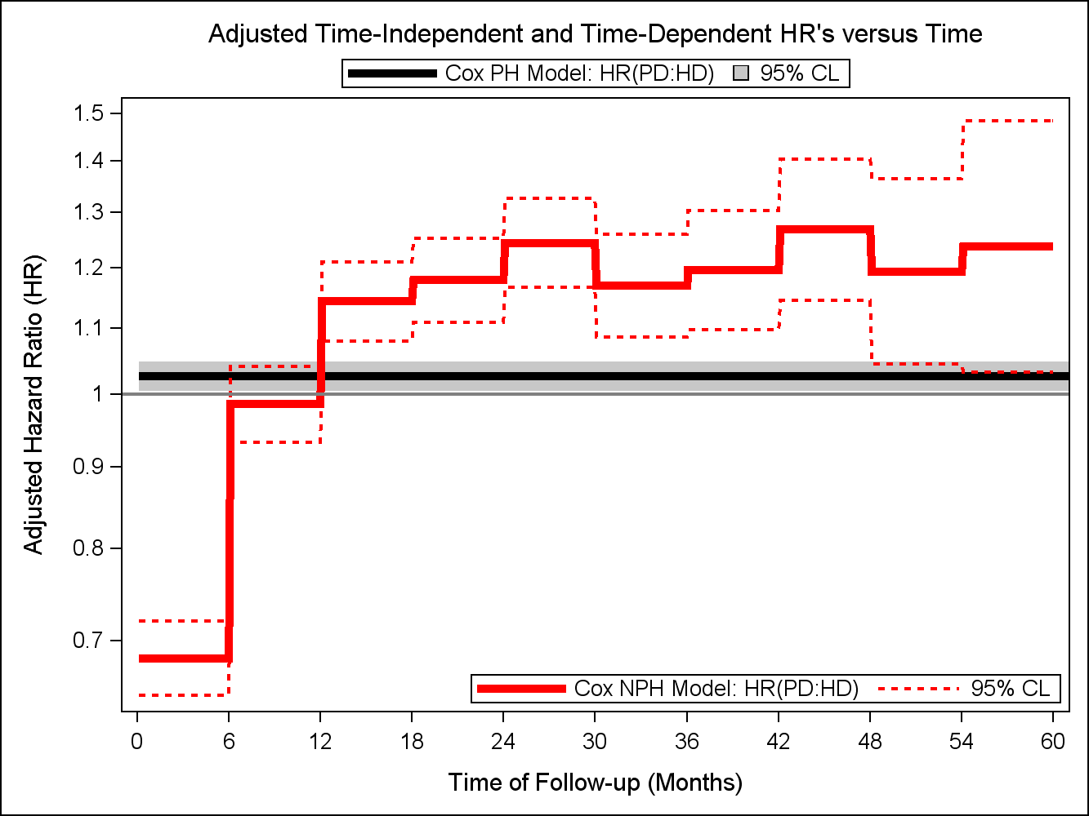
Adjusted HR’s from an Interval Cox NPH Model
Result:
This plot shows the
assumption of a constant
HR is false.
Question:
When does PD lose its survival advantage?

Slide 29
Time-dependent HR’s versus CHR’s
Interval |  | Interval Cox NPH Model
( t1 , t2 ] |  | HR(PD:HD) and 95% CI
0 | 6 | 0.68 | (0.65-0.72)^{c}
6 | 12 | 0.99 | (0.93-1.04)^{NS}
12 | 18 | 1.14 | (1.08-1.21)^{c}
18 | 24 | 1.18 | (1.10-1.25)^{c}
24 | 30 | 1.24 | (1.17-1.33)^{c}
30 | 36 | 1.17 | (1.09-1.26)^{c}
36 | 42 | 1.20 | (1.10-1.30)^{c}
42 | 48 | 1.27 | (1.15-1.40)^{c}
48 | 54 | 1.19 | (1.04-1.36)^{b}
54 | 60 | 1.24 | (1.03-1.48)ª
p-values: ^{NS} not significant; (p>0.05); ª p<0.05; ^{b} p<0.01; ^{c} p<0.001

Slide 30
Time-dependent HR’s versus CHR’s
Interval |  | Interval Cox NPH Model |  | Stratified Cox PH Model
( t1 , t2 ] |  | HR(PD:HD) and 95% CI |  | CHR(PD:HD) and 95% CI
0 | 6 | 0.68 | (0.65-0.72)^{c} | 0.69 | (0.63-0.76)^{c}
6 | 12 | 0.99 | (0.93-1.04)^{NS} | 0.82 | (0.76-0.90)^{c}
12 | 18 | 1.14 | (1.08-1.21)^{c} | 0.92 | (0.85-0.99)ª
18 | 24 | 1.18 | (1.10-1.25)^{c} | 0.98 | (0.90-1.07)^{NS}
24 | 30 | 1.24 | (1.17-1.33)^{c} | 1.03 | (0.95-1.13)^{NS}
30 | 36 | 1.17 | (1.09-1.26)^{c} | 1.06 | (0.97-1.16)^{NS}
36 | 42 | 1.20 | (1.10-1.30)^{c} | 1.08 | (0.98-1.18)^{NS}
42 | 48 | 1.27 | (1.15-1.40)^{c} | 1.10 | (0.99-1.22)^{NS}
48 | 54 | 1.19 | (1.04-1.36)^{b} | 1.11 | (0.99-1.24)^{NS}
54 | 60 | 1.24 | (1.03-1.48)ª | 1.13 | (0.99-1.27)^{NS}
p-values: ^{NS} not significant; (p>0.05); ª p<0.05; ^{b} p<0.01; ^{c} p<0.001

Slide 31
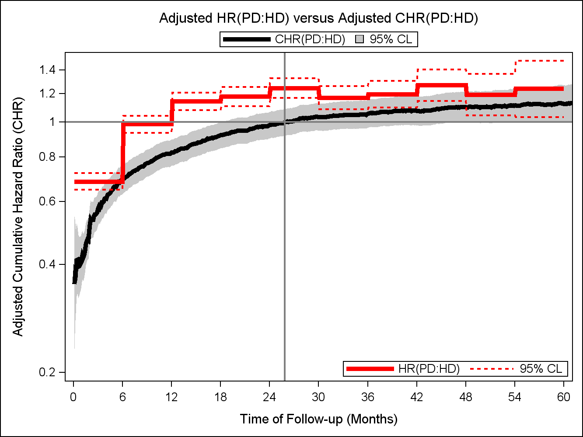
Time-dependent HR vs. CHR

Slide 32
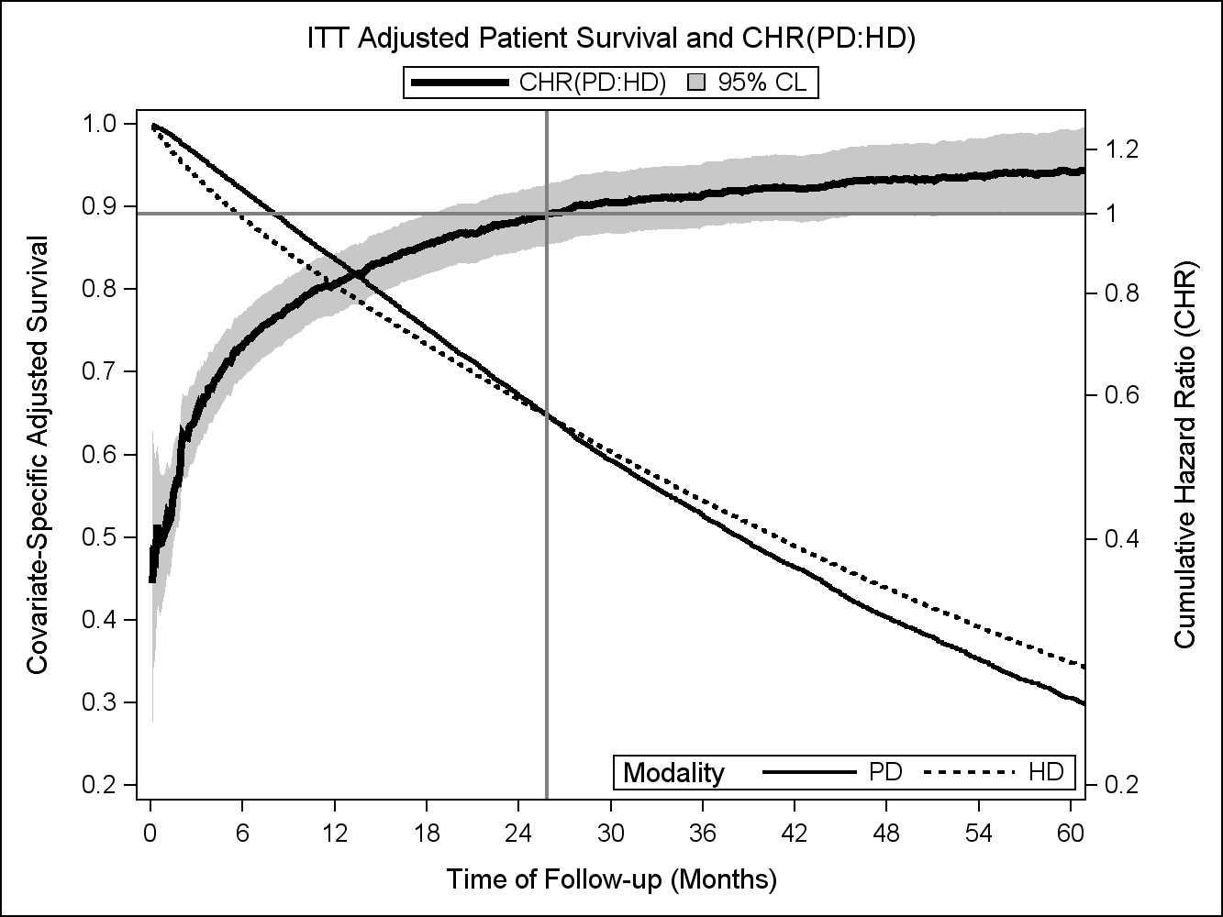
Direct Link Between Survival and the CHR

Slide 33
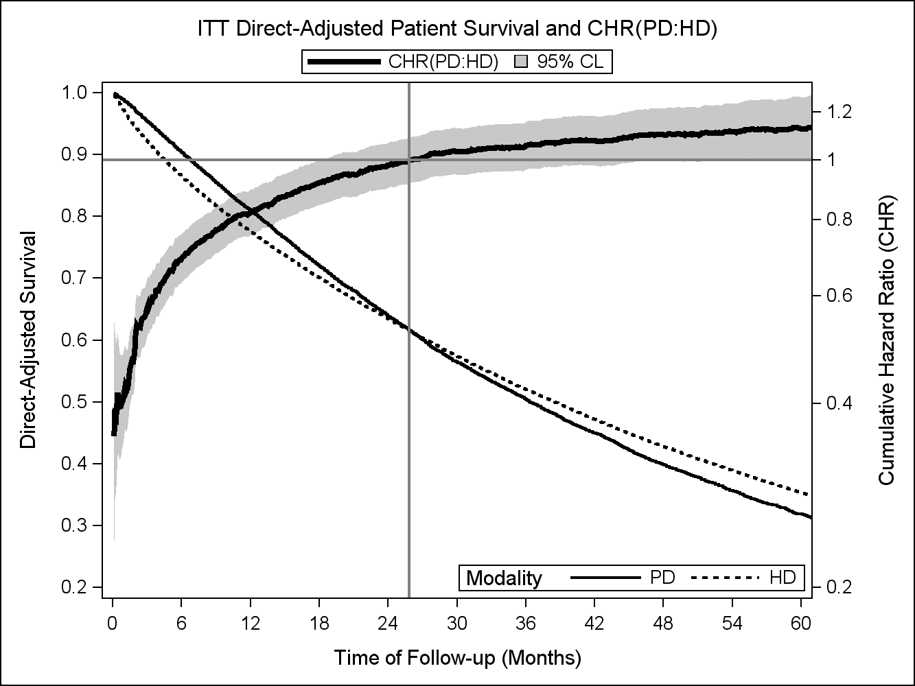
Direct Link Between Survival and the CHR

Slide 34
Examples
Kaiser Permanente Southern California ESRD Registry (KPSC-ESRD) – 2001-2013
  KPSC-ESRD registry involved N = 11,301 incident patients who started dialysis therapy in the United States between January 1, 2001 through June 30, 2013.
  Initial Treatment Modality
    HD: N = 10,298
    PD: N = 1,003
  Baseline Characteristics (Risk Factors/Covariates)
    Demographics (Gender, Age, Race, Year Initiated Trt)
    Clinical (Cause of ESRD, Charlson Comorbidity Index)
  Propensity score matching was used to form 1,003 PD and HD patients matched on propensity scores.

Slide 35
Kaiser Results: CHR(t) As-Treated vs ITT
Kumar VA, Sidell MA, Jones JP, Vonesh EF. Kid. International 86:1016-1022, 2014

Slide 36
Kaiser Results: CHR(t) vs Survival for ITT
Kumar VA, Sidell MA, Jones JP, Vonesh EF. Kid. International 86:1016-1022, 2014

Slide 37
Conclusions
In the presence of non-proportional hazards:
  The use of a constant hazard ratio (HR) based on a Cox proportional hazards model can yield very misleading results
  The use of time-dependent hazard ratios (HR’s) from a piecewise interval Cox model allows one to compare the current risk of death between PD and HD among patients still alive at the start of an interval. These hazard ratios are prone to misinterpretation.
  The use of the cumulative hazard ratio (CHR) allows one to compare the cumulative risk of death between PD and HD in a manner that coincides directly with predicted patient survival

Slide 38
Key References
Allison, PD. Survival Analysis Using the SAS System: A Practical Guide, 2nd Edition. SAS Institue, Cary, NC, 2010
Lee, ET. Statistical Methods for Survival Data Analysis. Lifetime Learning Publications, Belmont, CA, 1980.
Kalbfleisch, JD and Prentice, RL. The Statistical Analysis of Failure Time Data. Wiley and Sons, New York, 1980.
Vonesh EF, Snyder JJ, Foley RN and Collins AJ. Mortality studies comparing peritoneal dialysis and hemodialysis: What do they tell us? Kidney International 70: S3-S11, 2006.
Wei G, Schaubel DE. Estimating cumulative treatment effects in the presence of nonproportional hazards, Biometrics 64:724-732, 2008.
Yeates K, Zhu N, Vonesh E, et. al. Hemodialysis and peritoneal dialysis are associated with similar outcomes for end-stage renal disease treatment in Canada. Nephrol Dial Transplant 27:3568-3575, 2012.
Kumar VA, Sidell MA, Jones JP Vonesh EF. Survival of propensity matched incident peritoneal and hemodialysis patients in a United States health care system. Kidney International 86:1016-1022, 2014.
Zhang X, Loberiza FR, Klein JP and Zhang MJ. A SAS macro for estimation of direct adjusted survival curves based on a stratified Cox regression model. Computer Methods and Programs in Biomedicine 88:95-101, 2007.

Slide 39
Using SAS Macro: ADJSURV_CHR©
%ADJSURV_CHR calculates the direct-adjusted survival probabilities
for K treatment groups at all relevant time points for either a stratified Cox PH model (Model 1) or a regular Cox PH model (Model 2) based on the paper by Zhang et al (2007). Vonesh extended the macro by Zhang et. al. to also include computing adjusted cumulative hazard ratios so as to compare non-proportional hazards between the K treatment groups using the methods described by Wei and Schaubel (Biometrics, 2008) for a stratified Cox model. The approach by Wei and Schaubel uses the robust covariance matrix of Lin and Wei for the stratified model (Model 1 option) when computing the variance of the cumulative hazard ratio (CHR). This has been updated by Vonesh to include using a stratified Cox model which allows for clustered survival data (e.g., matched pairs) in which robust standard errors of the CHR are computed based on score residuals aggregated over the cluster-specific levels.
LIMITATIONS: It is based on SAS 9.2 version of PHREG but does not incorporate a CLASS statement (it only allows numeric covariates).

Slide 40
THE END

